Slide 1

Integrated Computational Materials Engineering (ICME)
John Allison
University of Michigan
ICME Short Course
June 8, 2017

Slide 2
250
200°C
Al-4Cu
Al-4Cu-0.05Sn
Al-4Cu-0.3Mg
Al-4Cu-0.3Mg-0.5Si
Al-4Cu-0.3Mg-0.4Ag
200
Al-4Cu-0.3Mg-0.4Ag-1Li
150
Hardness (VHN)
100
50
0
1
10
100
Ageing Time (h)
Courtesy of J. F. Nie

Slide 3


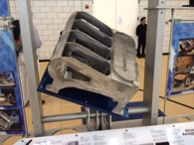
It takes 10-20 years to develop a new material
Societal and global competitiveness requires us to do this faster and cheaper!
250
200°C
Al-4Cu
Al-4Cu-0.05Sn
Al-4Cu-0.3Mg
Al-4Cu-0.3Mg-0.5Si
Al-4Cu-0.3Mg-0.4Ag
200
Al-4Cu-0.3Mg-0.4Ag-1Li
1989
150
Hardness (VHN)
100
1906
50
0
1
10
100
Ageing Time (h)
Courtesy of J. F. Nie

Slide 4
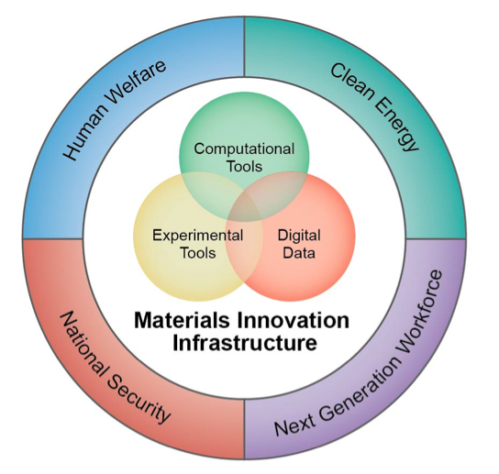
Materials Genome Initiative
. . . This initiative offers a unique opportunity for the United States to discover, develop, manufacture, and deploy advanced materials at least twice as fast as possible today, at a fraction of the cost.
President Barack Obama, 24 June 2011
Announcing the Materials Genome Initiative
“(In this context) genome connotes a fundamental building block toward a larger purpose” NSTC MGI White Paper, 2011

Slide 5
Outline
Integrated Computational Materials Engineering (ICME) – What it is and why it’s important
Virtual Aluminum Castings – An ICME Case Study at Ford
ICME – The Next Big Thing in Structural Materials and An Essential Element of MGI
Thoughts on ICME for Integrated Computational Materials Education (ICME for ICME)

Slide 6
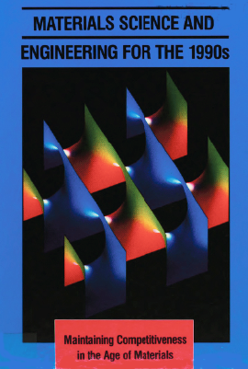

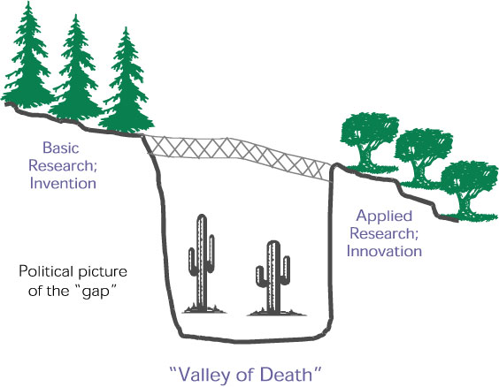




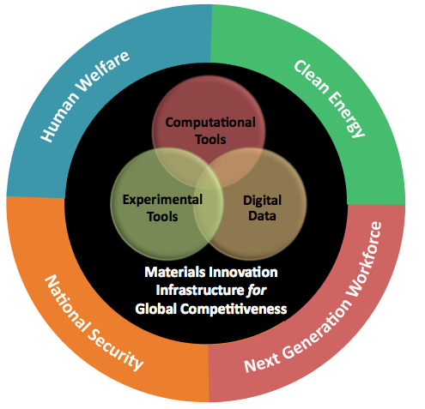
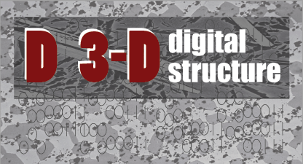

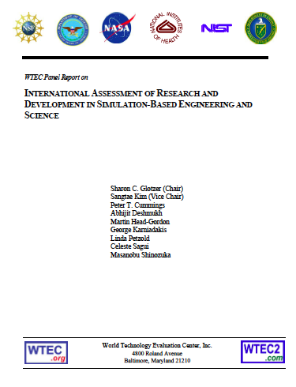
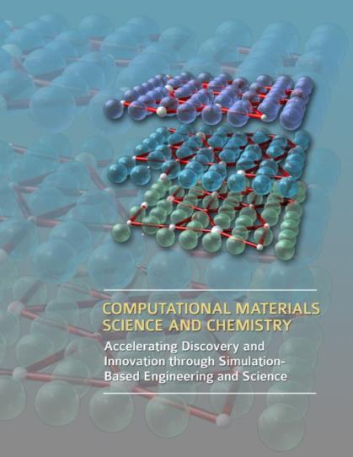
ICME/MGI Historical Highlights
1989
1995
DOE: Advanced Strategic Computing Initiative
NRC: The Valley of Death
NRC: Materials Science & Eng for the 1990s
2001
European Union
1999
AFOSR-MEANS
DARPA-AIM
Virtual Aluminum Castings
ONR-D3D
NRC-ICME
WTEC-SBES
BES-ASCR
2004
2008
2009
2010
2011
We are at a tipping point!

Slide 7
Materials Genome Initiative
. . . This initiative offers a unique opportunity for the United States to discover, develop, manufacture, and deploy advanced materials at least twice as fast as possible today, at a fraction of the cost.
President Barack Obama, 24 June 2011
Announcing the Materials Genome Initiative
“(In this context) genome connotes a fundamental building block toward a larger purpose” NSTC MGI White Paper, 2011

Slide 8
Materials Genome Initiative
Coordinated Multi-agency effort – DOE, DOD, NSF, NIST with White House OSTP leadership
$150M / year “10 year program”
Essential ingredients
  Collaboration
  Integration of theory,
    simulation and experiments
  Information Infrastructure
  Workforce development
  ICME
These represent important building blocks for ICME

Slide 9
A Well-Equipped Workforce
(Excerpt from 6/2014 MGI Strategic Plan)
… the next generation of materials scientists and engineers must be able to expertly use these tools to achieve the success promised by MGI….
.. before the future generation workforce can be equipped to take advantage of the Materials Innovation Infrastructure, instructors must first be provided information on these new tools, research approaches, and their value.

Slide 10
US National Materials Advisory Board - Committee on Integrated Computational Materials Engineering (ICME)
Tresa Pollock, Chair
John Allison,
Vice Chair
2008
Free Download: http://books.nap.edu/catalog/12199/
Notes:
10

Slide 11
The Vision
Computationally-driven materials development is a core activity of materials professionals in the upcoming decades, uniting materials science with materials engineering and integrating materials more holistically and computationally with product development.
11
Notes:
11

Slide 12
Integrated Computational Materials Engineering (ICME) is the integration of materials information, captured in computational tools, with engineering product performance analysis and manufacturing-process simulation.*
What is ICME?
Chemistry
Thermodynamics
Diffusion
Quantitative
Processing-Structure Relations
Quantitative
Structure-Property Relations
Engineering Product Performance Analysis
Process & product optimization
Innovation
Manufacturing
Process
Simulation
Constitutive Models
* NAE ICME Report, 2008

Slide 13
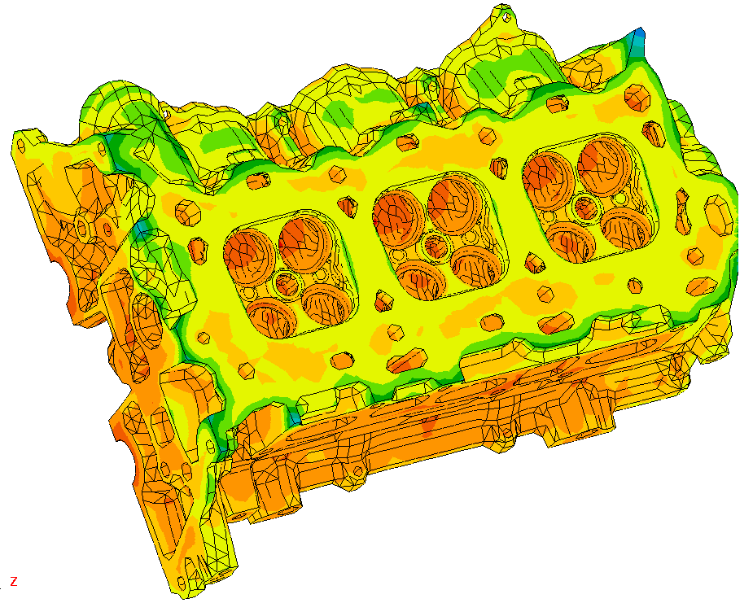
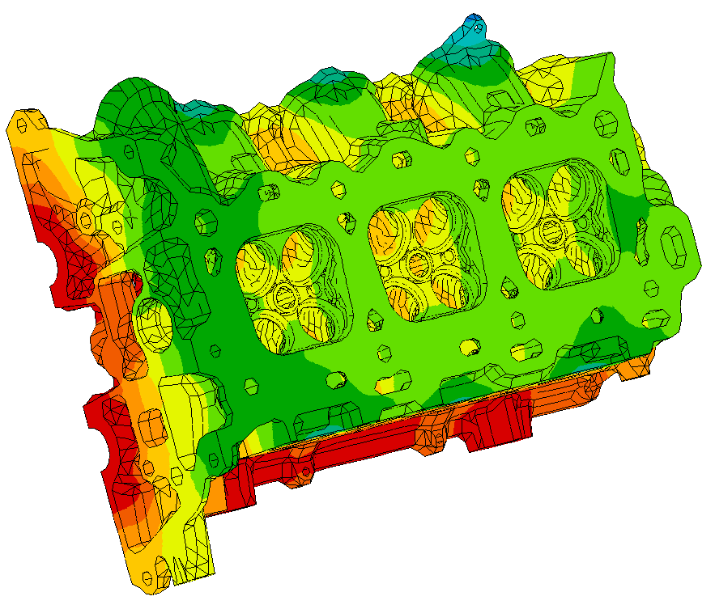
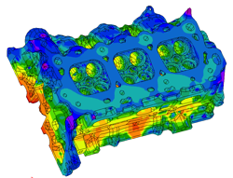
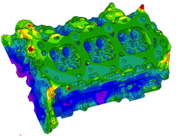
Integrated Computational Materials Engineering (ICME) is the integration of materials information, captured in computational tools, with engineering product performance analysis and manufacturing-process simulation.*
What is ICME?
Manufacturing
Process
Simulation
Product Performance Analysis
Microstructure
Distribution
Property Distribution
Process & product optimization
Innovation
* NAE ICME Report, 2008

Slide 14
Using advanced computational techniques, designs can be studied and optimized in matters of hours or days. Optimization of new materials must be done experimentally and can take 10-20 years.
Shape optimization of hypersonic vehicles
Source: K. Bowcutt, Boeing

Slide 15
Why this is important
Innovations in materials and tight coupling of component design, materials and manufacturing have been key sources of industrial competitiveness
These innovations and tight coupling are threatened by advances in computational capability in design and manufacturing that have “left materials field in the dust”.
The global economy requires efficient engineering, manufacturing and R&D

Slide 16
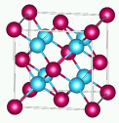
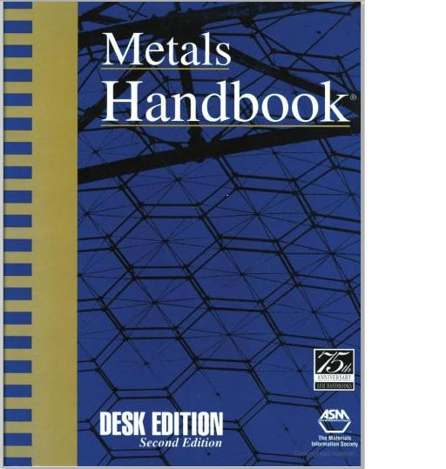

The Divide Separating
Materials Science and Materials Engineering
Predicted Volume Change
Quantum Mechanics
Theory
γ
Calculated
Phase Diagram
Kinetics Experiment
Thermal Growth

Slide 17
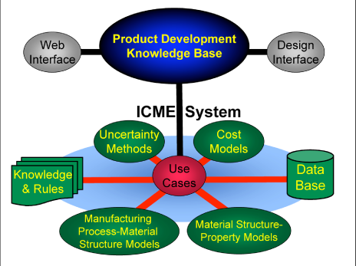
Integrated Computational Materials Engineering provides a means to link:
  Science and Engineering
  Manufacturing, Materials and Design
  Experiments, Theory, Simulation
  Information Across Disciplines
8

Slide 18


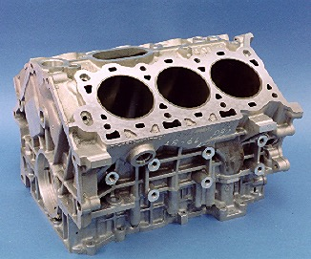

Ford Virtual Aluminum Castings

Slide 19
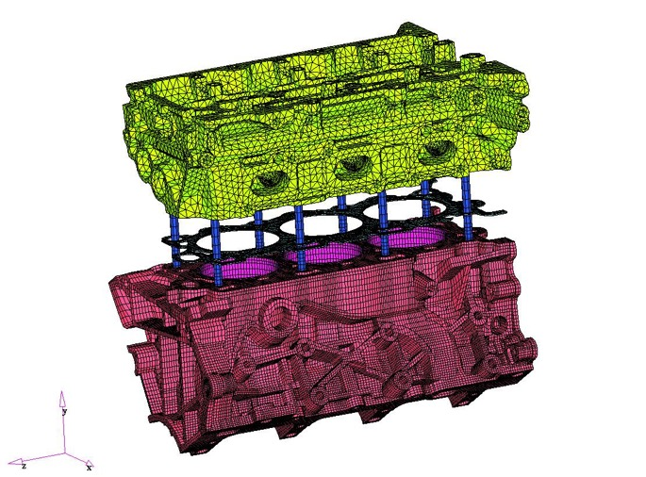
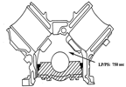
Traditional Durability Analysis
ABAQUS
Load
Inputs
Initial
Geometry
Durable
Component
Predict
Service
Life
Y
N
Database of
Material
Properties

Slide 20
Traditional Durability &
Manufacturing Analysis
MagmaSOFT/ ProCast
ABAQUS
Load
Inputs
Initial
Geometry
Durable
Component
Ensure
Castability
Predict
Service
Life
Model
Casting
Y
Y
N
N
Database of
Material
Properties

Slide 21
Traditional Product Development Process
ProCAST/MagmaSOFT
ABAQUS
Load
Inputs
Initial
Geometry
Durable
Component
Ensure
Castability
Build, Test,
Re-Build,
Re-Test
Predict
Service
Life
Model
Casting
Y
Y
N
N
Database of
Material
Properties

Slide 22

Rearrange the Production Simulations
MagmaSOFT/ ProCAST
ABAQUS
Product and Process
Product
Property
Requirements
Product
Property
Requirements
Predict
Residual
Stress
Load
Inputs
Meet Property
Requirements
Optimized
Process &
Product
Optimized
Component
Initial
Geometry
Ensure
Castability
Model
Casting
and Heat
Treatment
Predict
Local
Micro-
structure
Predict
Local
Properties
Predict
Service
Life
Y
Y
Y
N
N
N
Alloy
Composition

Slide 23
Virtual Aluminum Castings
The Ford Experiment in ICME
MagmaSOFT / ProCAST
ABAQUS
Product and Process
Product
Property
Requirements
Product
Property
Requirements
Predict
Residual
Stress
Load
Inputs
Meet Property
Requirements
Optimized
Process &
Product
Optimized
Component
Initial
Geometry
Ensure
Castability
Model
Casting
and Heat
Treatment
Predict
Local
Micro-
structure
Predict
Local
Properties
Predict
Service
Life
Y
Y
Y
N
N
N
Alloy
Composition

Slide 24
Materials Engineering is all about compromises – ICME provides a means to conduct quantitative tradeoffs
Cast Aluminum Processing-Structure-Property Linkages
Casting
Heat Treatment
Processing
Solution Treatment
Aging
n
Chemistry
Thermodynamics/
Kiinetics
Microstructure
Micro porosity
Eutectic Phases
Precipitation
Properties
High Cycle Fatigue
Low Cycle Fatigue
Yield Strength
Thermal Growth

Slide 25
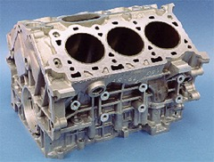
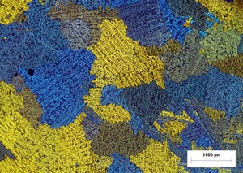
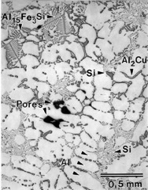
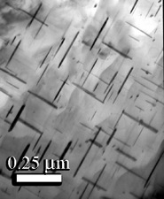
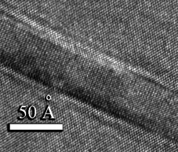
Key metallurgical processes occur at many length scales – and all can be influenced by manufacturing history
1 m
Engine Block
1 – 10 mm
Macrostructure
Grains
Macroporosity
Properties
• High cycle fatigue
• Ductility
10 – 500um
Microstructure
Eutectic Phases
Dendrites
Microporosity
Intermetallics
Properties
• Yield strength
• Tensile strength
• High cycle fatigue
• Low cycle fatigue
Thermal Growth
• Ductility
1-100 nm
Nanostructure
Precipitates
Properties
• Yield strength
Thermal Growth
• Tensile strength
• Low cycle fatigue
• Ductility
0.1-1 nm
Atomic Structure
Crystal Structure
Interface Structure
Properties
• Thermal Growth
Yield Strength

Slide 26
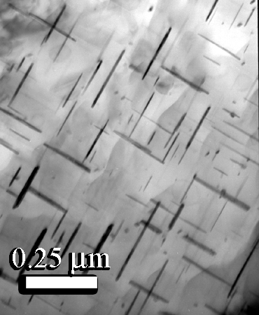
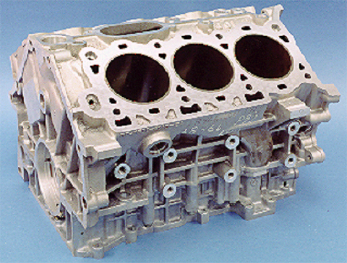
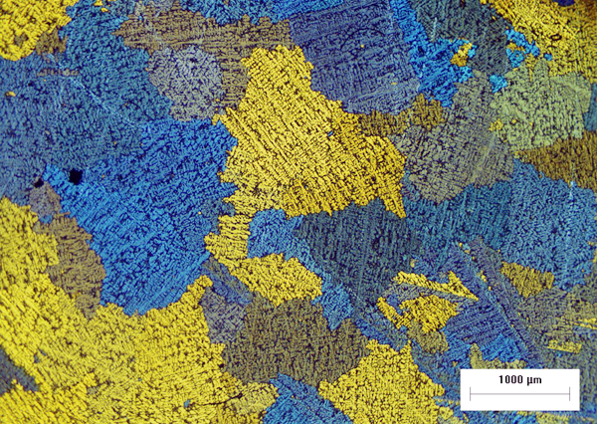
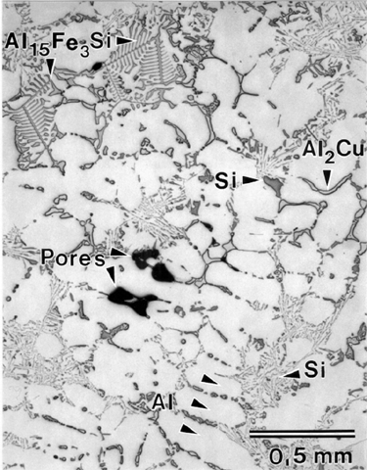
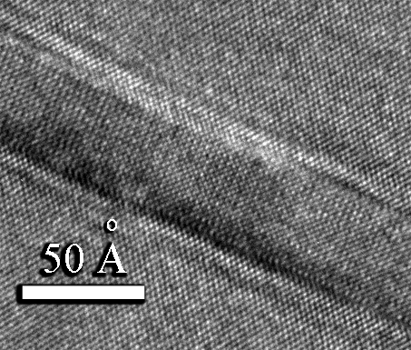
Microstructures
1 m
Cast Aluminum
Engine Block
1 – 10 mm
0.1-1 nm
10 – 500μm
1-100 nm
0.1-.3nm

Slide 27
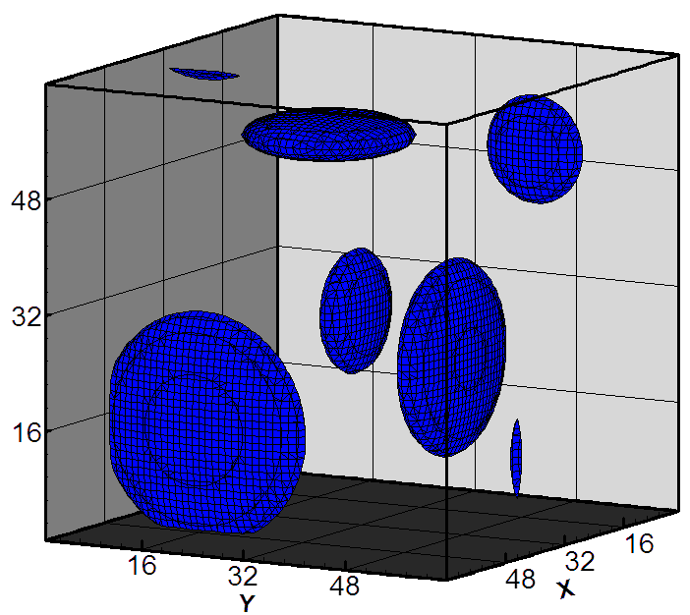
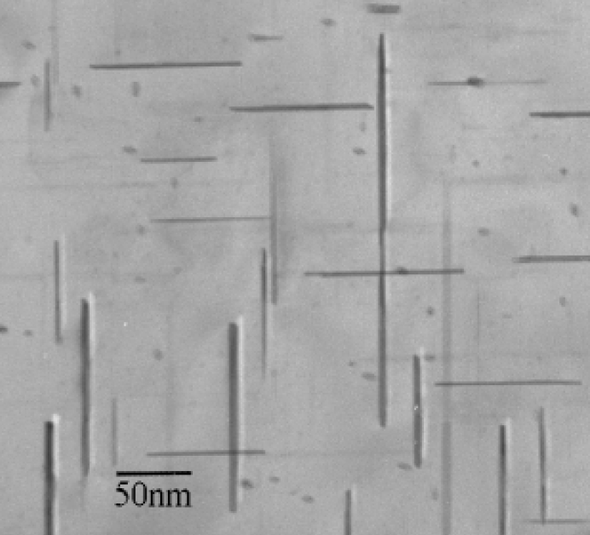
θ’ Al₂Cu Precipitates
Li, Zhang, Chen, Allison

Slide 28
Physics Based Models –
Yield Strength
Yield strength (σ_{Y}) is the sum of an intrinsic strength (σ_{i}), a precipitation hardening strength (σ_{ppt}), and a solid solution strength (σ_{ss}):
Zhu & Starke, 1999
f = volume fraction of theta’
d = diameter of theta’ platelet
w= thickness of theta’ platelet

Slide 29
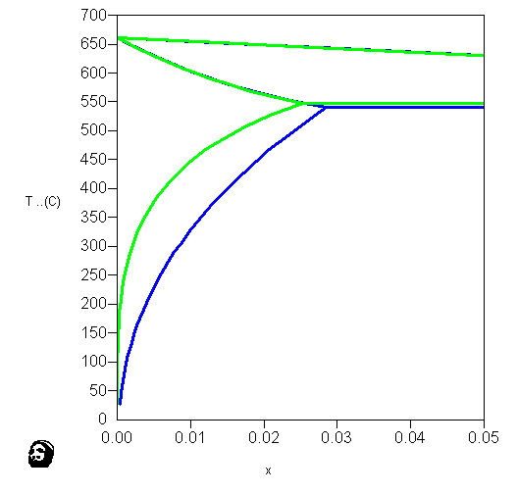
First-Principles Modification of Al-Cu Phase Diagram Incorporating Metastable
θ’-phase
Liquid
(Al)
Temperature, ºC
Metastable states just as easy to calculate as stable states
θ-phase
θ’-phase
Al
Mole Fraction Cu
Notes:
29

Slide 30


VAC models capture experimental understanding
where robust physics-based models are not available
TEM Characterization of Precipitate Morphology vs Aging Time
(319 Al alloy with 3, 3.5 and 4%Cu)

Slide 31
Aging Response of 319 Aluminum
Prediction vs. Experimental

Slide 32
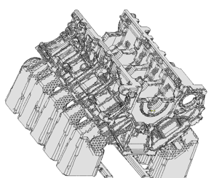
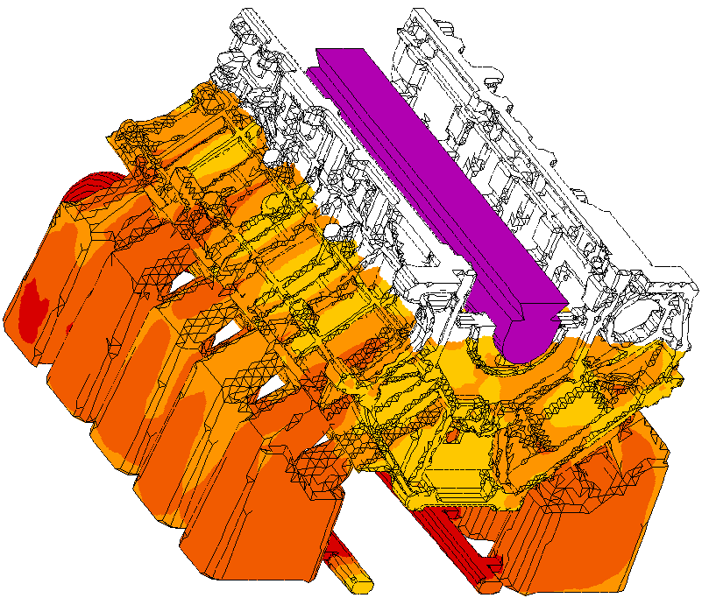
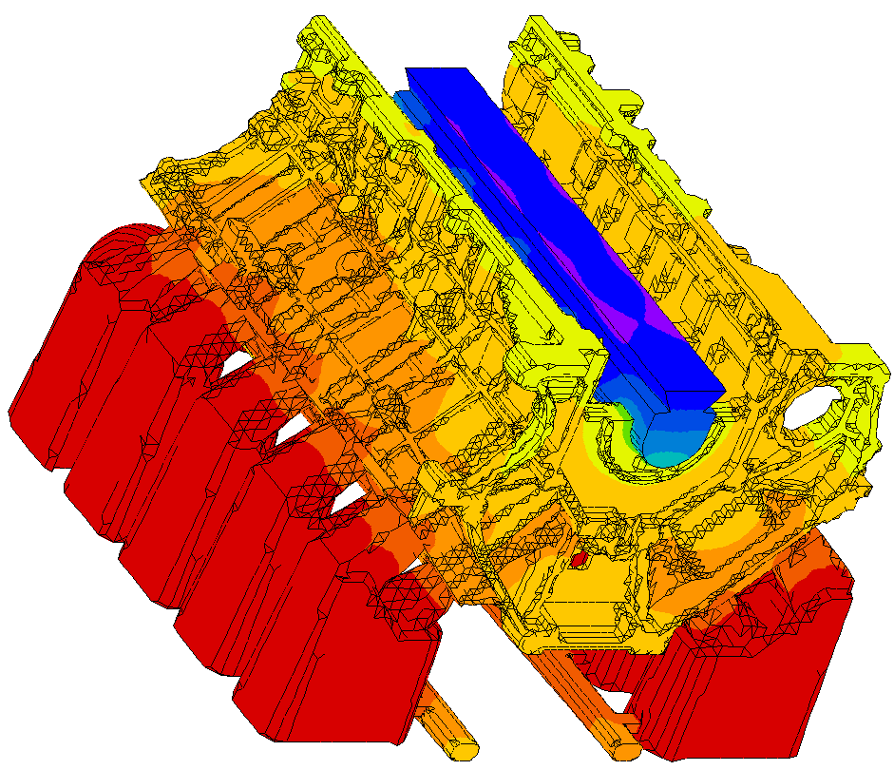
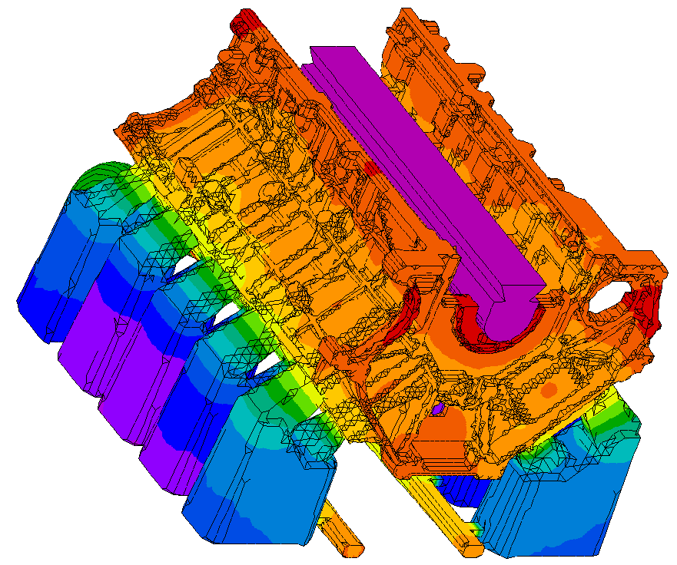
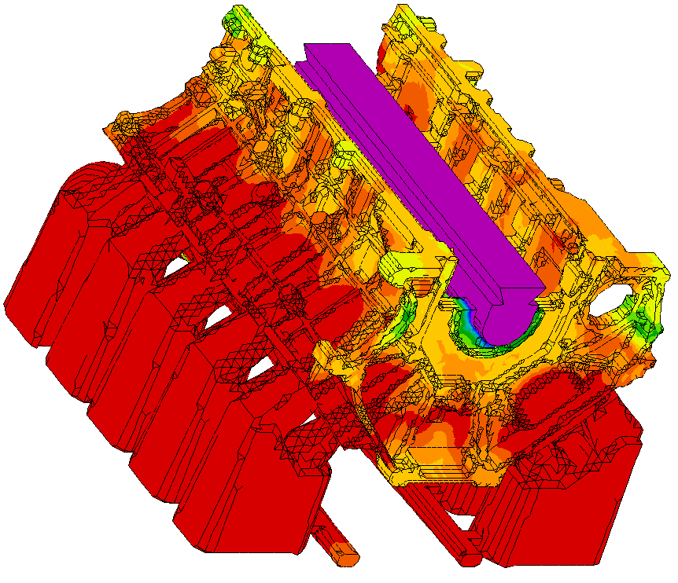
Virtual Aluminum Castings Process Flow
Local Yield Strength Prediction
Initial Geometry
CAD Geometry
and Mesh
Filling
Accurate filling Profile (OptCast)
Thermal Analysis
Boundary Conditions (OPTCAST)
Fraction solid Curves (ThermoCALC)
Yield Strength
Aging Model
(ThermoCALC)
Microstructure (Al₂Cu)
Micromodel (ThermoCALC)
Empirical Kinetics (OPTCAST)

Slide 33
Model Validation & Accuracy
Normal Production Region

Slide 34
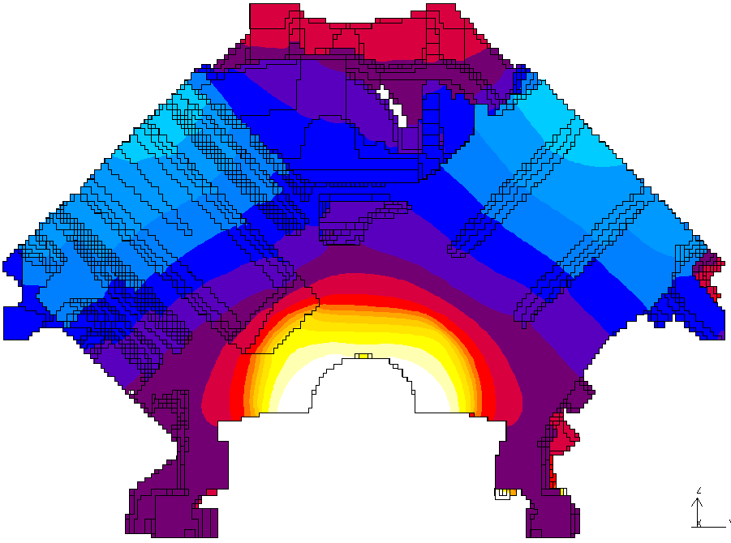

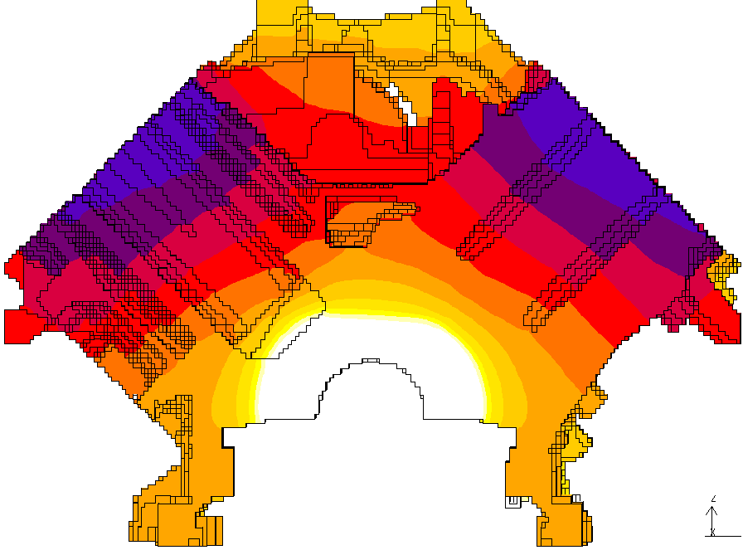
Using Virtual Aluminum Castings in Product and Process Optimization
Target Strength = 220 MPa
210
230
Aging at 250C for 3hrs
220
Aging temperature 240C for 5hrs
Initial Heat Treatment
Process
205
Optimized Heat Treatment Process
Faster and Stronger !!

Slide 35
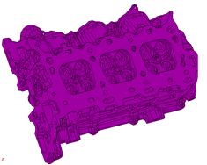
Local Fatigue Strength Prediction
Initial Geometry
Filling Analysis
Thermal Analysis
Local Porosity
Local Fatigue Strength

Slide 36
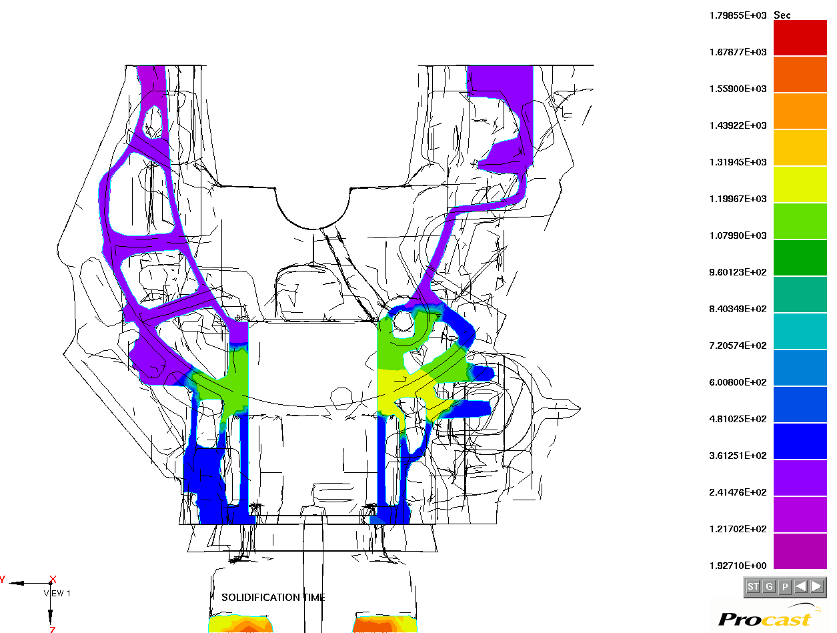
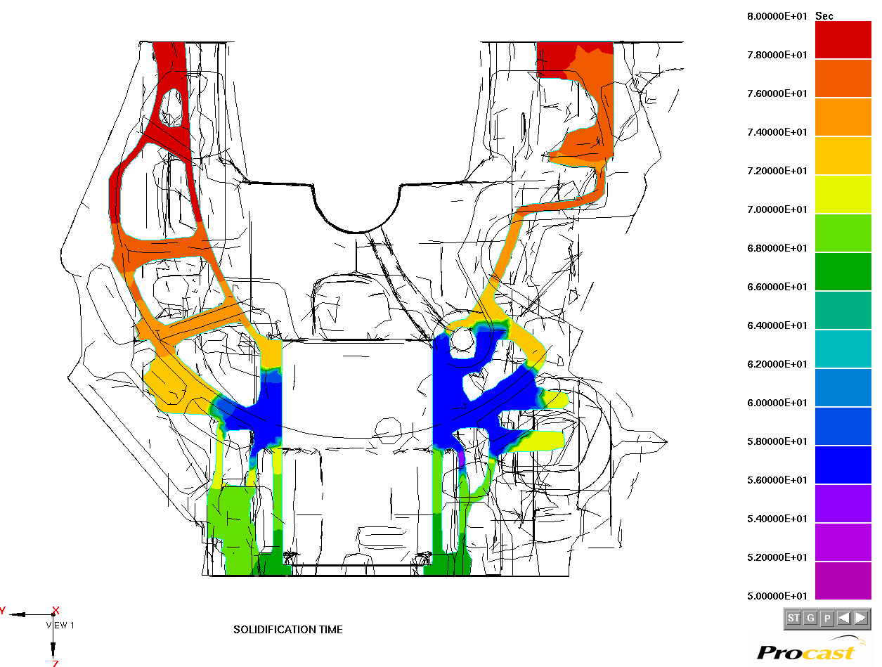
Prediction of Local Fatigue Strength
Micro Porosity
Pore Size (Microns)
200 Microns
1200 Microns
Fatigue Strength
MPa
500 Microns
80+ MPa
56 MPa
67 MPa

Slide 37
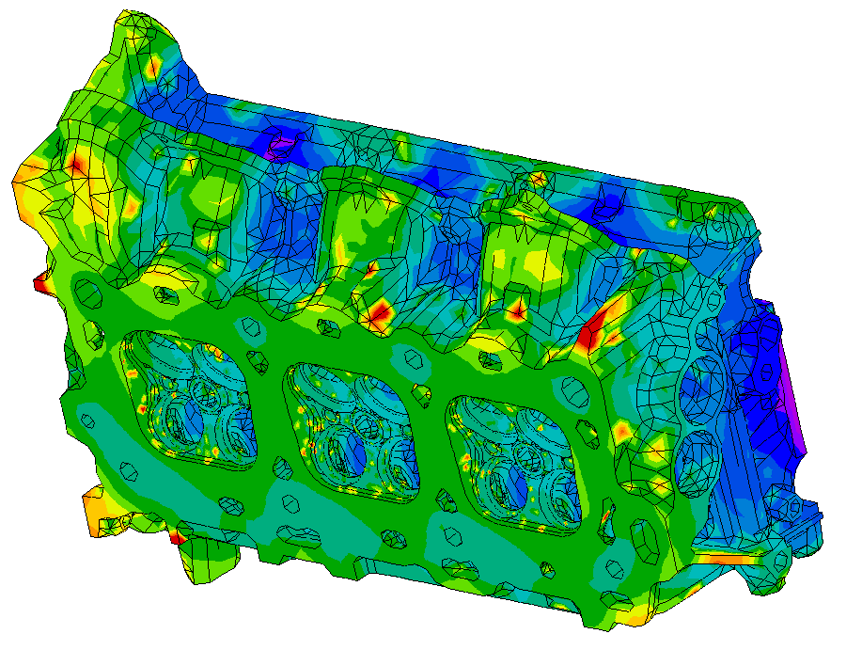
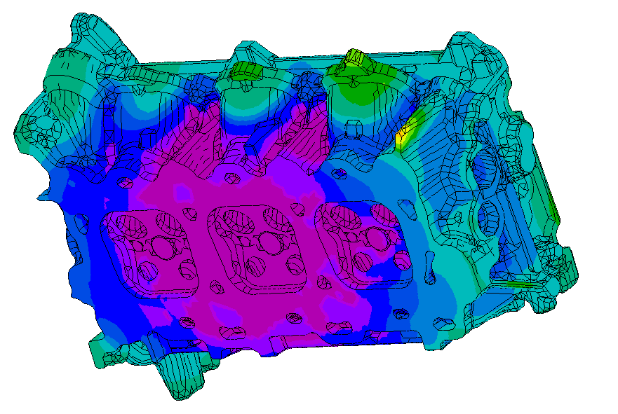
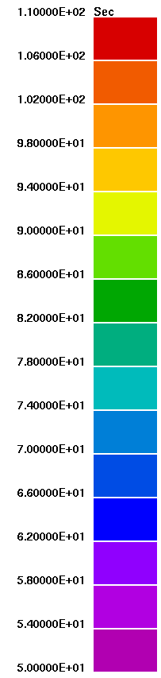
Use of ICME For
New Process Development and Selection
Local Fatigue Strength
VAC enabled an unprecedented acceleration in the time for process development and selection
56MPa
84MPa
Low Pressure Casting
Gravity Casting

Slide 38
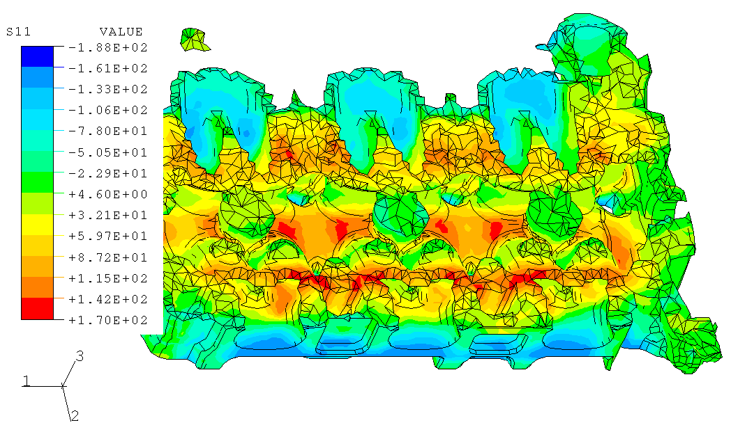
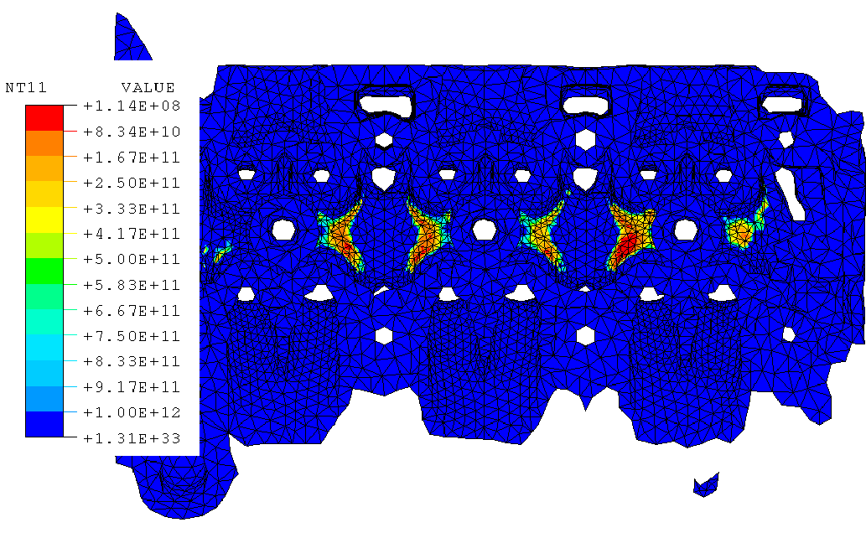
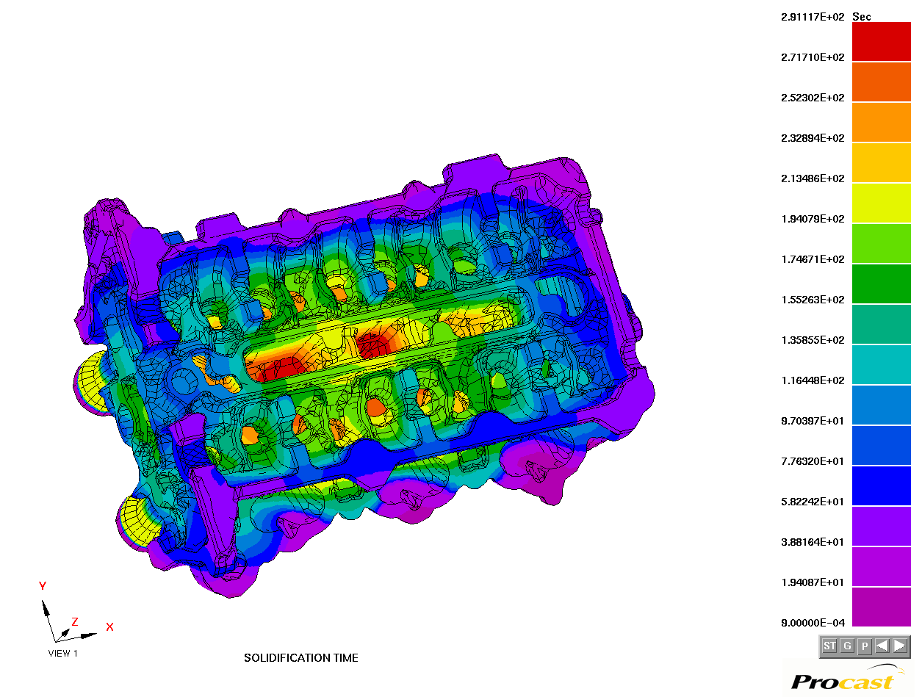
Virtual Aluminum Castings
Linking Manufacturing, Materials and Design
Local Residual Stresses
Component Durability
Component Durability
Local Fatigue Properties

Slide 39
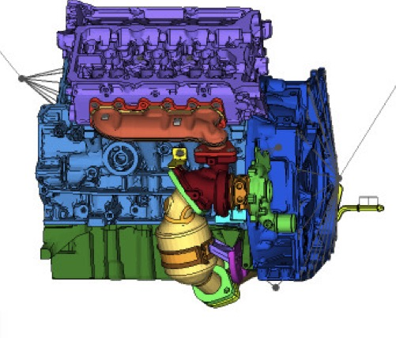
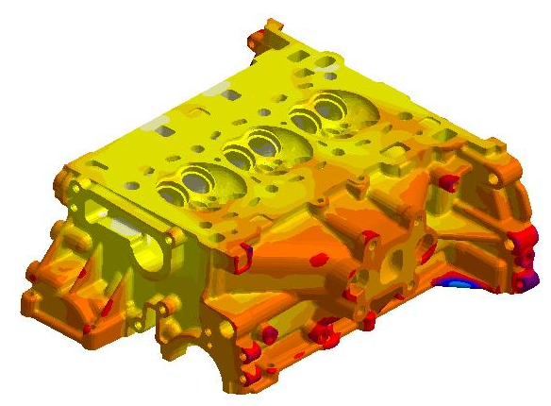
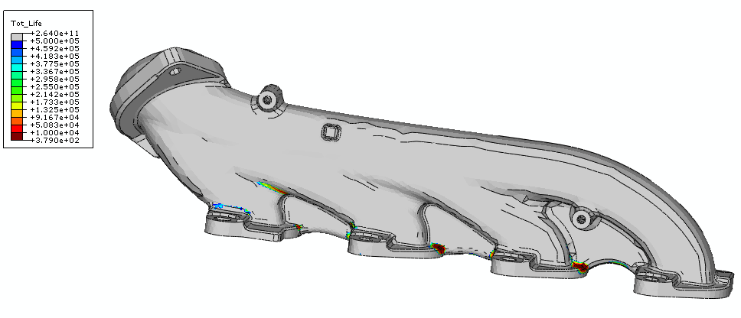
ICME enables materials to be part of the design optimization process
Example: Advanced Exhaust Manifold Design (800-900°C)
Solution 2: Use Ford Virtual Aluminum Castings
Integration of exhaust manifold into cast aluminum cylinder head
VAC enabled an unprecedented acceleration in the time for new component design and virtual manufacture and testing
Solution 1:
New Cast Steel Alloy Design

Slide 40
Virtual Aluminum Castings (VAC)
ProCAST/MagmaSOFT
ABAQUS
Product and Process
Product
Property
Requirements
Product
Property
Requirements
Predict
Residual
Stress
Load
Inputs
Meet Property
Requirements
Optimized
Process &
Product
Optimized
Component
Initial
Geometry
Ensure
Castability
Model
Casting
and Heat
Treatment
Predict
Local
Micro-
structure
Predict
Local
Properties
Predict
Service
Life
Y
Y
Y
N
N
N
Alloy
Composition

Slide 41


The VAC Business Case
Targets
IMPROVE TIMING: Reduce product
and process development time 15-25%
IMPROVE QUALITY:
  Improve launch quality /reduce scrap
  Eliminate failures during product development
  Ensure high mileage durability
IMPROVE PERFORMANCE:
  Enable high performance heads & blocks
  Reduce weight of components
REDUCE COST:
  Cost reduction/avoidance over $120M
GLOBAL USERS
  North American Powertrain Operations
  European Powertrain Ops
  Ford of Asia-Pacific (China &
    Australia)
  Mazda
  (Volvo/Jaguar)

Slide 42
VAC Modeling Methods
Ab Initio / First Principles Theory (VASP etal)
Phase Field Models
Thermodynamic Equilibria & Diffusion (ThermoCalc, Pandat & Dictra)
Phenomenological micromodels for microstructural evolution & mechanical properties
Continuum mechanics models
  Micromechanics
  Constituitive models (State Variable and Classical Plasticity)
  Crystal Plasticity (FEM)
Optimization Techniques (DOT, iSight)
Manufacturing Simulation Software
  Fluid Flow – CFD (Fluent, ProCast, MagmaSoft)
  Solidification (MagmaSoft, ProCast)
  Thermal analysis (MagmaSoft, ProCast, Abaqus)
  Stress Analysis (Abaqus)

Slide 43
Ford VAC R&D Team
Ford R&A VAC Team
  John Allison
  Mei Li
  XuMing Su
  Larry Godlewski
  Carlos Engler
  Bob Frisch
  Joy Hines Forsmark
  John Lasecki
  Jake Zindel
  Eben Prabhu
  Richard Chen
Former Team Members
  John Allison
  Ruijie Zhang
  Nagendra Palle
  Chris Wolverton (NW)
  Bill Donlon
  Ravi Vijayraghavan
  Don Siegel (UofM)

Slide 44
Ford VAC - University Partners
University of Michigan – Prof. Wayne Jones
  Aging models of Aluminum Alloys
  Porosity-fatigue models for 319 Al
  Ultrasonic fatigue (NSF)
Imperial College –Prof. Peter Lee
  Microporosity modeling
Tsinghua University – Prof. Baicheng Liu
  Modeling HPDC processes
Pennsylvania State University – Prof. L. Chen
  Modeling microstructural evolution (NSF)
University of Wisconsin – Prof. A. Chang
  Thermodynamics Models for Cast Al & Mg (SBIR)
Ohio State University – Prof. S. Ghosh
  Modeling Ductility in Cast Al (NSF)
University of Illinois – Prof. H. Sehitoglu/ J. Dantzig
  Modeling Thermal-Mechanical Fatigue of Cast Aluminum
  Prediction of residual stresses/quench cracking in Cast Aluminum
  Optimization Methodologies

Slide 45
ICME/MGI Historical Highlights
1989
1995
DOE: Advanced Strategic Computing Initiative
NRC: The Valley of Death
NRC: Materials Science & Eng for the 1990s
2001
European Union
1999
AFOSR-MEANS
DARPA-AIM
Virtual Aluminum Castings
ONR-D3D
NRC-ICME
WTEC-SBES
BES-ASCR
2004
2008
2009
2010
2011
We are at a tipping point!

Slide 46
ICME “Case Studies” have
demonstrated the promise
Early ICME implementations have been successful in a wide variety of industries
Benefits have included more rapid product development, reduced testing costs and more efficient engineering
Return-on-investments in the range of 3:1 to 9:1 have been realized.
Typical investments were in the $5-20M range.
Notes:
46

Slide 47

Selected Conclusions
Industrial acceptance of ICME is hindered by the slow conversion of science-based materials computational tools to engineering tools and by the scarcity of materials engineers trained to use them.
ICME as a discipline within materials science and engineering does not yet truly exist - ICME is in it’s infancy.
For ICME to succeed, it must be embraced as a discipline by the materials science and engineering community

Slide 48





Materials represents a different class of computational problem
Materials response and behavior involve a multitude of physical phenomena with no single overarching modeling approach.
Capturing the essence of a material requires integration of a wide range of modeling approaches dealing with separate and often competing mechanisms and a wider range of length and time scales.
There are over 160,000 engineering materials!
Processing
Casting
Heat Treatment
Solution Treatment
Chemistry
n
Aging
Thermodynamics
Microstructure
Micro porosity
Eutectic Phases
Precipitation
Properties
High Cycle Fatigue
Low Cycle Fatigue
Yield Strength
Thermal Growth
Integration of knowledge domains is
essential to ICME

Slide 49

Foundational Engineering Problems
Include a manufacturing process(es), a materials system and an application or set of applications that define the critical set of materials properties and geometries
Examples of FEPs
  Lightweight, blast resistant titanium structures
  Superalloy turbine disks for aeropropulsion
  Low cost silicon solar cells
$10-40M per FEP (3-5 year funding)
Prioritize modeling, experimental, data issues to be tackled
Provide a framework for assembly of multidisciplinary teams
Provide near-term payoff (and thus increased buy-in & investment)
Serve as the foundation for this emerging discipline

Slide 50
What are some additional examples of Foundational Engineering Problems?

Slide 51

Current Status of ICME
ICME in use at many large companies
ICME - Foundational Engineering Problems
  Forged Ni Turbine Disk Residual Stresses (AFRL/RX)
  ICME Methods for Composite Materials (AFRL/RX)
  Next Generation Auto Sheet Steels (DOE-EERE)
  ICME-Enabled Cast Al alloy development (DOE-EERE) – 3 programs!
  ICME-Enabled Cast Fe alloy development (DOE-EERE) – 2 programs!
  LIFT – ICME Projects

Slide 52


Residual Stress Engineering in Ni Structures
Foundational Engineering Problem (FEP)
Residual stress represents pervasive issue to metals industrial base
Significant “tech pull” from OEM designers and materials suppliers
Significant potential impact:
Reduced development time (decades to years)
Reduced component life cycle cost (up to 50%)
Increased efficiency (up to 20% lower weight)
Reduced scrap at production and depot
Life extension of legacy components
Bulk Residual Stress
Surface Residual Stress
Program developing ICME framework for incorporating residual stress in design of nickel structures
Link disparate materials models for optimization
Integrate computational materials modeling into industrial standard design practice
Define path for pervasive infrastructure needs
  Complementary AFRL In-House Research
  Critical fundamental R&D to enhance industrial toolset, conducted by technical experts at AFRL and academia
“….. to accelerate the
development and application of ICME to critical defense platforms.”

Slide 53








ICME Guided Development of
Advanced Cast Aluminum Alloys For
Automotive Engine Application
Hotter Engine
Faster Development
T_{peak} = 300 °C
75 % of T_{melting}
Current alloy < 250 °C
TMF at valve bridge
Other failure
Thermal Efficiency
η_{th} = 1 – T_{en} / T_{op}
Traditional Alloy Design
10-20 yr
ICME
Integrated Computational Materials Engineering
Virtual Aluminum Casting “From Atom to Engine”
Alloy Design by ICME ?
2-3 yr
From alloy composition to engine component
New Alloy

Slide 54



Lightweight Innovations for Tomorrow
New Metals National Manufacturing Innovation Institute
Led by UM, Ohio State U & Edison Welding
Over 100 member consortia of industry, academia and national labs
ICME FEPs are a key technology focus for LIFT
Broadening participation in ICME is a key goal
Materials Commons will be LIFT collaboration platform

Slide 55
Cyberinfrastructure for ICME
To fully reach its potential, ICME requires new advances in networking, computing, and software:
    Curated, repositories for data and material models and simulation tools
    Linkage of application codes with diverse materials modeling tools
    Geographically dispersed collaborative research
    Dispersed computational resources (Grid computing)
Notes:
55

Slide 56

Lessons Learned from Other Fields
ICME Complexity and Magnitude Similar to Bioinformatics
Tools and linked databases to develop a better understanding of the molecular processes affecting health and disease
Curated Databases
NIH Requirement
Information Infrastructure in other fields have demonstrated the power of sharing information
$$$
National Center for Biotechnology Information

Slide 57
MGI/ICME
Information Infrastructure
UM Materials
Commons
NIST
3D
Materials
Atlas
Georgia
Tech
MatIN
MGI/ICME information infrastructure is beginning to appear
Loose “confederation” is starting to form
Miss. State U.
EVOCD
MDF
ChiMAD
/NIST
Dream 3D
ASM/Granta
LLNL
Materials
Project
Duke
AFLOWLIB
U. Minn.
KIMM
USAF-
FEPs
NASA
MAPTIS
$

Slide 58
Materials Information Infrastructure
Data Curation
Data Storage
Data Mining
Data Processing
EXTERNAL SERVICES
EXPERIMENTS
COMPUTATIONS
CLOUD SERVICES
Materials Commons
Materials Data Facility
PROVENANCE
ORGANIZE
SHARE
PUBLISH
STANDARDIZE
CURATE
COLLABORATE
NIST/MDCS
SCIENTIFIC WORKFLOW

Slide 59


The Materials Commons
A unique collaborative environment
Seamless part of scientific workflow including provenance
APIs for Autoingest from PRISMS Codes
Collaboration environment
Interoperable part of growing Materials Information Infrastructure
Publically available Summer 2016

Slide 60



The Materials Commons
A Use Case: Precipitate Evolution
TEM Images
Quantitative Characteristics
Library of
Analytical Expressions, e.g.
r³=DϒX_{c}t-r₀³
Coarsening
kinetics
Phase Field Simulation (using
Experimental info to “Parameterize
Nucleation Kinetics)
Inputs from CASM
Comparing Experiments and Simulation
Nucleation Kinetics

Slide 61

Precipitate Evolution – Future Use of Data In Materials Commons
TEM Images
Characteristics available in images which have not been quantified –
but future researcher may need.

Slide 62
PRISMS Center – Vision of Success
PRISMS – extensible scientific core for ICME for structural metals
Provide the capability for rapid insertion of the latest science into the engineering process
Chemistry
Thermodynamics
Diffusion
Quantitative
Processing-Structure Relations
Quantitative
Structure-Property Relations
Engineering Product Performance Analysis
Process & product optimization
Innovation
Manufacturing
Process
Simulation
Constitutive Models

Slide 63












PRISMS Center Integrated Framework
Enabling accelerated predictive materials science
Real Space DFT
PRISMS-RSDFT
Dislocation Dynamics
LLNL-ParaDIS
EXPERIMENTS (slip,
twinning, crack, etc.)
Statistical Mechanics
CASM
Fourier Space DFT
(e.g. VASP)
Continuum Plasticity
PRISMS-Plasticity
Phase Field
PRISMS-PF
Crystal Plasticity
PRISMS-Plasticity
Phase Diagrams
CASM/CALPHAD
EXPERIMENTS
(TEM, APT)
Atomistic
LAMMPS

Slide 64
Materials Genome Initiative
Coordinated Multi-agency effort – DOE, DOD, NSF, NIST with White House OSTP leadership
$150M / year “10 year program”
Essential ingredients
  Collaboration
  Integration of theory,
    simulation and experiments
  Information Infrastructure
  Workforce development
  ICME

Slide 65
ICME/MGI Historical Highlights
1989
1995
DOE: Advanced Strategic Computing Initiative
NRC: The Valley of Death
NRC: Materials Science & Eng for the 1990s
2001
European Union
1999
AFOSR-MEANS
DARPA-AIM
Virtual Aluminum Castings
ONR-D3D
NRC-ICME
WTEC-SBES
BES-ASCR
2004
2008
2009
2010
For ICME to succeed, it must be embraced as a discipline by the materials science and engineering community
2011
We are at a tipping point!

Slide 66
Materials Genome Initiative
Coordinated Multi-agency effort – DOE, DOD, NSF, NIST with White House OSTP leadership
$150M / year “10 year program”
Essential ingredients
  Collaboration
  Integration of theory,
    simulation and experiments
  Information Infrastructure
  Workforce development
  ICME

Slide 67
ICME: Current Status in Education and Professional Societies
Educational Efforts
  ICMEd Short Course
  Northwestern U: ICME Certificate Program
  Mississippi State U: ICME Course
Professional Society Efforts (examples)
  TMS International ICME Congress: 2011, 2013, 2015, 2017
  TMS “How To” Guide for Systematic ICME Implementation & Short Course
    http://www.tms.org/icmestudy/
  AIAA ICME Symposia
  AIAA/ASME/TMS Symposia

Slide 68
What are some things you can do to embed ICME into your curricula?
68

Slide 69
Integrating ICME into our curriculum
Develop awareness that ICME is possible and valuable
NAE ICME Study: www nae.edu/19582/Reports/25043.aspx
Use ICME tools as a means to enhance the learning experience within the current curricula (but they’re not available yet as integrated tools…)
Therefore focus on:
  Collaboration & Teamwork
  Integration - computational methods & experiments (labs)
  Linkages between specialty areas
  Linkages between science and engineering (Decision Making) – Cross-Disciplinary Design Courses

Slide 70
ICME in MSE 420 & MSE 520
Undergraduate & Graduate Level
Mechanical Behavior
Include ICME as part of the syllabus & a thread throughout the course
Finite Element Analysis Module
  Lecture 1 – Overview (ICME)
  Lecture 2 – COMSOL Hands-on Demo
  2 Homeworks
Team Projects – Matlab ICME Modules

Slide 71
ICME in MSE 470
Undergraduate Level
Physical Metallurgy
Include ICME as part of the syllabus & a thread throughout the course
ThermoCalc & TC PRISMA Analysis Module
  Lecture 1 – Overview (ICME)
  Lecture 2 – ThermoCalc & TC PRISMA Hands-on Demo
  3 Homeworks
Team Projects – Matlab ICME Modules

Slide 72
Team Project
“Educational Module”
Matlab-based model that describes a microstructure-mechanical property (or in MSE 470 a Processing-Microstructure) relationship
Could be used in an undergraduate project to teach a concept – or as part of a larger ICME educational module.
Deliverables:
Model, Paper and Presentation

Slide 73

Properties of Particle Strengthened Aluminum
Notes:
Maybe run the program here~

Slide 74

Influence of Alloying Elements on Solidification in Ni-based Superalloys
Alloy Options
Varied: Concentrations, Liquidus Slope, Partition Coefficients
Result: Solidification Temperatures vs. Remained Liquid Fraction for different segregating elements

Slide 75
ICME (Cast Aluminum) Processing-Structure-Property Linkages
Casting
Heat Treatment
Processing
Solution Treatment
Aging
n
Chemistry
Thermodynamics/
Kinetics
Microstructure
Micro porosity
Eutectic Phases
Precipitation
Properties
High Cycle Fatigue
Low Cycle Fatigue
Yield Strength
Thermal Growth

Slide 76
Curriculum Linkages
Casting
Heat Treatment
Processing
Solution Treatment
Aging
n
Chemistry
Thermodynamics/
Kinetics
Microstructure
Micro porosity
Eutectic Phases
Precipitation
Properties
High Cycle Fatigue
Low Cycle Fatigue
Yield Strength
Thermal Growth

Slide 77
Materials Processing
Curriculum Linkages
Casting
Heat Treatment
Processing
Solution Treatment
Aging
n
Chemistry
Thermodynamics/
Kinetics
Microstructure
Micro porosity
Eutectic Phases
Precipitation
Thermo/Kinetics
Physical Metallurgy
Mechanical Behavior
Properties
High Cycle Fatigue
Low Cycle Fatigue
Yield Strength
Thermal Growth

Slide 78
SUMMARY
Integrated Computational Materials Engineering (ICME) offers a means to link:
  Manufacturing, materials and product development
  Engineering and scientific disciplines
  Information across knowledge domain
Virtual Aluminum Castings is an example
  integrated, comprehensive suite of CAE tools that capture extensive expertise in cast aluminum processing, metallurgy & design and provides it to a global engineering workforce.
ICME is an essential ingredient of the Materials Genome Initiative (MGI) and the Next Big Thing in Structural Materials
For the transformational benefits of ICME and MGI to be realized - educators will play a central and critical role.

