Slide 1
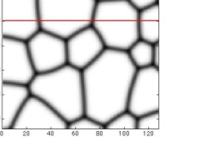
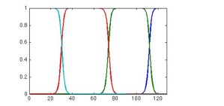
Phase Field Modeling
Instead of tracking interfaces explicitly, the phase field method tracks the values of “order parameters”
The value of order parameter remains uniform in one phase, and continuously transitions to another uniform value in the another phase
The locations of interfaces are automatically defined by the transitioning region of the order parameter
Wide variety of applications including solidification, precipitation, grain growth, and batteries
Multiphase systems
Polycrystalline materials

Slide 2
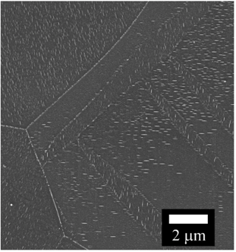
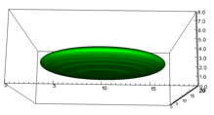
Motivation and Requirements for the PRISMS Phase Field Code
Microstructure simulations often require very large calculations
These are terascale computational problems with 10⁶ to 10⁹ DOF
For grain growth, need the ability to track 100s of grains
Many different governing equations fall under the umbrella of “phase field modeling”, need flexibility
Finite Element Method
  Easily allows mesh adaptivity, arbitrary geometries, and high order of accuracy
  Can build from well-established community codes (e.g. deal.II)
  Allows a shared toolset with PRISMS-Plasticity and PRISMS-RSDFT
  However, need a low memory approach to compete with finite difference
2

Slide 3
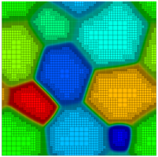
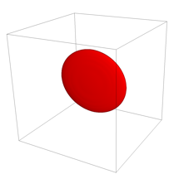
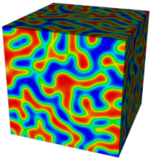
PRISMS-PF:
An Open Source, Finite Element,
General Purpose Phase-Field Platform
(github.com/prisms-center/phaseField)
User-Friendly:
Simple interface to solve an arbitrary number of PDEs
Detailed user guide
11 applications (and counting) to get you started
High-Performance:
Ideal scaling for >1,000 processors
Matrix-free method permits >10⁹ DOF
Adaptive meshing
Competitive performance with finite difference (even without adaptive meshing)

Slide 4
Structure of PRISMS-PF
Core library
  Generates mesh, does the finite element calculation, outputs files, etc.
Apps
  Each app is a directory that contains (at least) three input files
    parameters.h: Numerical parameters, including meshing options, time step, etc.
    equations.h: Governing equations
    ICs_and_BCs.h: Initial conditions and boundary conditions
  Copy and paste an app directory to create a new app
Tests
  Suite of unit and regression tests

Slide 5
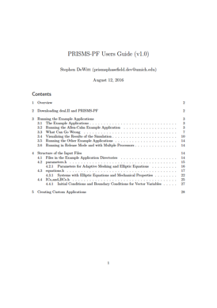
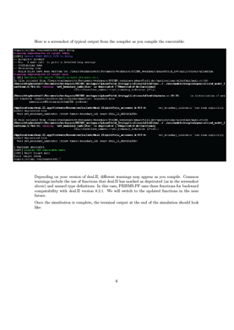
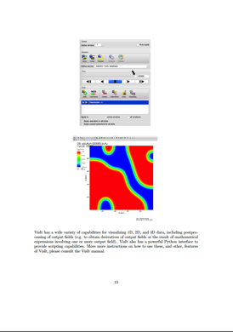
User’s Guide
Instructions for downloading and installing PRISMS-PF and pre-requisites
Instructions for running the pre-built applications and visualizing the results
A description of the input files and how to create custom applications

Slide 6
Three Types of PRISMS-PF Users
Uses PRISMS-PF applications
  No C++ knowledge needed
  No deal.II knowledge needed
Creates PRISMS-PF applications
  Minimal C++ knowledge needed
  No deal.II knowledge needed
Extends PRISMS-PF itself
  C++ knowledge needed
  deal.II knowledge needed

Slide 7
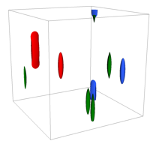

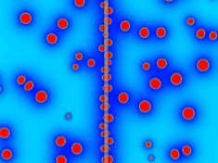
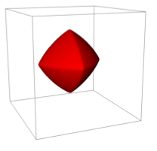



Phase Field Modeling at the PRISMS Center
Mg-RE Precipitates
Precipitation near Grain Boundaries
Strong Interfacial Energy Anisotropy
Spinodal Decomposition in Strained Thin Films (Non-PRISMS)
7

Slide 8


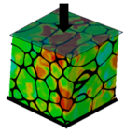
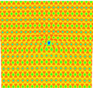


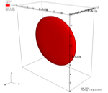
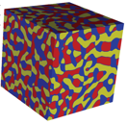

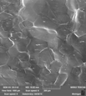
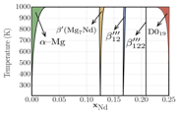

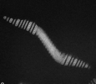
PRISMS Center Precipitate Use Case
Atomic scale
constitutive laws
Dislocation Dynamics
(LLNL-ParaDIS)
Crystal Plasticity
(PRISMS-Plasticity)
Real Space DFT
(PRISMS-RSDFT)
Statistical Mechanics
(CASM)
Continuum Plasticity
(PRISMS-Plasticity)
Phase Field
(PRISMS-PF)
Mechano-Chemistry
(PRISMS-MC*)
Fourier Space DFT
(VASP)
Phase Diagrams
(CASM/CALPHAD)
Experiments (slip,
twinning, crack, etc.)
Phase Field Crystal
(PRISMS-PFC*)
Experiments

Slide 9
Example Use Case: Precipitation
CASM submits VASP calculations and performs cluster expansions
CASM passes homogenous free energies, interfacial energies, mechanical properties to PRISMS-PF
PRISMS-PF predicts precipitate microstructure, validated by experiments
PRISMS-PF passes microstructure to ParaDIS to calculate CRSS
Dislocation Dynamics
(LLNL-ParaDIS)
Statistical Mechanics
(CASM)
Phase Field
(PRISMS-PF)
Fourier Space DFT
(VASP)
Experiments
9

Slide 10


Precipitates in Mg-RE Alloys
Mg alloys are of interest for lightweighting in automotive and aerospace applications
Mg-RE alloys, such as Mg-Nd and Mg-Y have among the best mechanical properties of Mg alloys
β’’’ precipitates with habit planes perpendicular to the basal plane block dislocation motion
Plots courtesy E. Deda, A. Githens (UM)
Schematics: J.F. Nie, Met. Trans. A, 43A, 3891 (2012)

Slide 11
Experimental Motivation: The Precipitation Sequence
GP
GP
β₁
β’’’
GP
β’’’
β’’’

Slide 12


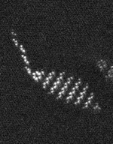
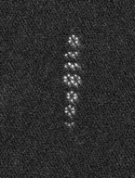
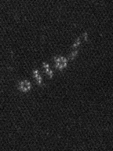
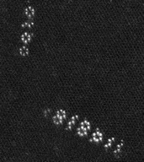
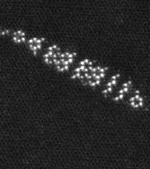
First-principles: Metastable hcp ground states
2 nm
2 nm
2 nm
2 nm
2 nm
Sitzman, Marquis

Slide 13
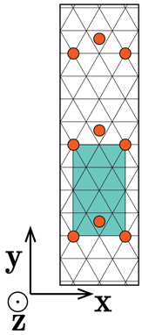


Why are the β’’’ orderings observed?

Slide 14
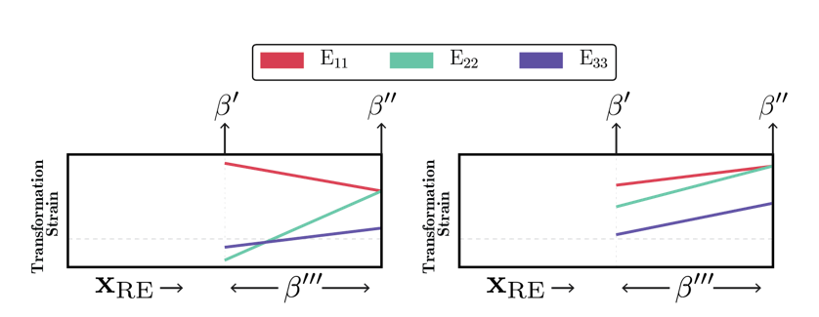
Two Types of β’ Structures with Different Expected Behavior

Slide 15
Predictions for the other Mg-RE alloys

Slide 16

Phase Field Model Can Calculate Equilibrium Shape and Composition
Use inputs from first principles calculations to predict Mg-Nd β’’’ shape and composition
No fitting parameters
Yields a lenticular precipitate

Slide 17
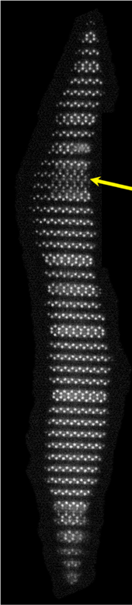
Simulated composition within experimental range, suggests β’’’ structure
β’’
Simulated composition 0.138–0.146 Nd
Notably elevated above β’ composition
Consistent with experimental range [1], 0.125–0.167 Nd
β’
Hex Row
Zig-zag Row
Alternating hexes and zig-zags would be 0.15 Nd
[1]
[1] Natarajan et al., Acta Mater. 2016
Notes:
Actual values: 0.146, 0.141, 0.140, 0.138
If hexes and Ns alternated, this is the <0^2 1> ordering, with composition of 0.15
Decreasing composition consistent with Gibbs-Thomson effect

Slide 18
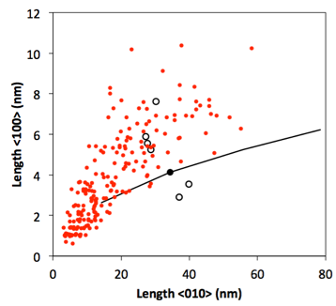
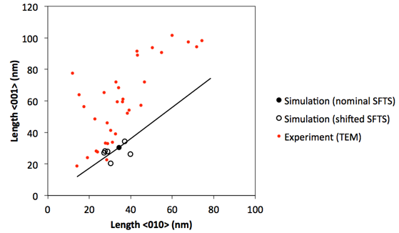
Quantitative Comparison to Experiments
Comparing predicted equilibrium dimensions to experimental dimensions, including the effect of uncertainty

Slide 19
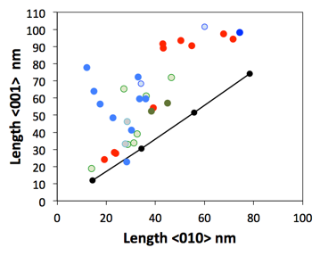
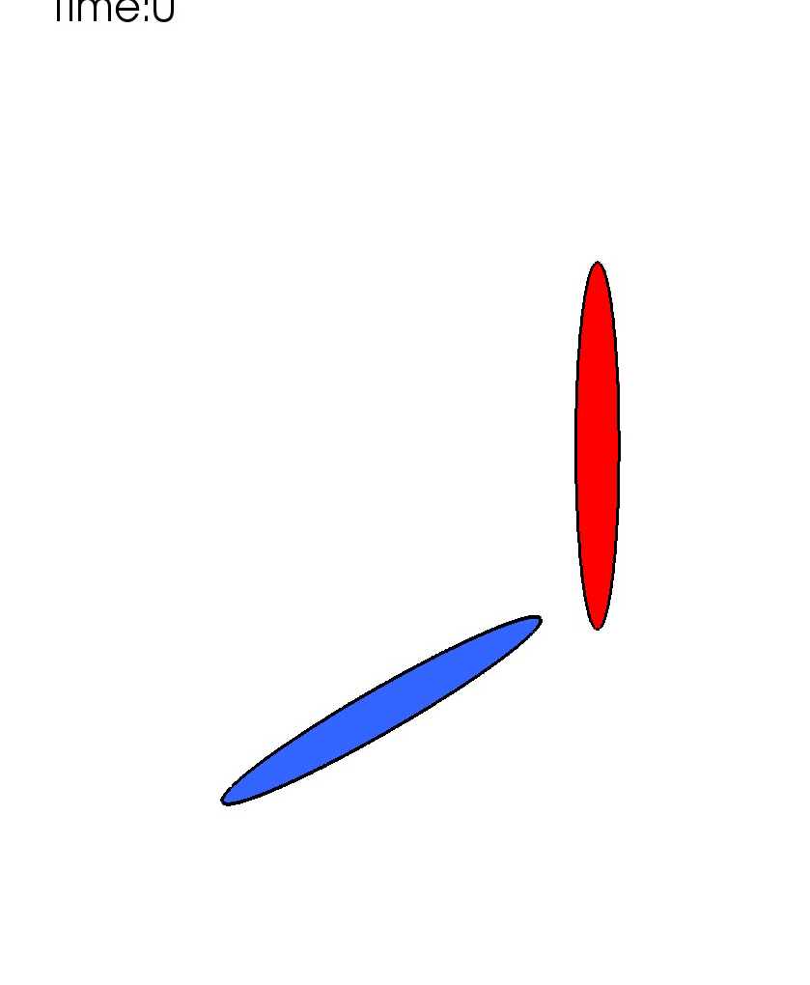
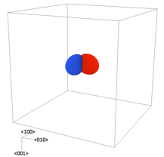
Non-Equilibrium Effects on Morphology
Simulation of two precipitates in this configuration demonstrates this mechanism:
Growth along <010> could be impeded by a neighboring precipitate of another variant
<010>
<100>

Slide 20
Summary: Precipitate Use Case
Example of the ICME methodology in action
Brings together first principles calculations, phase field simulations, and experiments
Obtain fundamental mechanistic understanding of the precipitates in Mg-RE alloys and a platform for microstructure prediction
Effort underway to link these capabilities to dislocation dynamics and crystal plasticity to predict precipitate strengthening
Natarajan et al., On the early stages of precipitation in dilute Mg-Nd alloys, Acta Mater. 108 (2016).
Natarajan and van der Ven, A unified description of ordering in HCP Mg-RE alloys, Acta Mater. 124 (2017).
Solomon et al., Early precipitate morphologies in Mg-Nd-Zr alloys, Scripta Mater. 128 (2017)
DeWitt et al., Misfit-Driven β''' Precipitate Composition and Morphology in Mg-Nd Alloys, Acta Mater. (submitted)

Slide 21
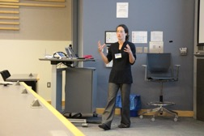


PRISMS Annual Workshop
PRISMS Center holds workshops annually, along with training sessions
Next workshop: Ann Arbor, MI
  August 14-16: PRISMS Workshop Software Training
  August 17-18: PRISMS Center Workshop Technical Symposia
Limited financial aid is available – contact me!

Slide 22
Summary
The PRISMS Center is focused on providing new computational tools and a framework for the structural metals community and demonstrating on advanced Mg alloys.
Working together we are making great progress and generating:
  Exciting new science!
  Software: Available on GitHub
  Information via Materials Commons: Stay Tuned
We encourage you to use and co-develop these tools and join us at our next workshop Aug 14-18, 2017.

Slide 23
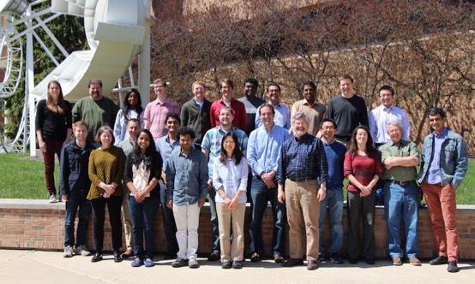


Thanks!
Find us online at: prisms-center.org
Funding for the PRISMS Center is provided by the US Dept. of Energy, Office of Basic Energy Sciences under award #DE-SC0008637

Slide 25
Performance Benchmarks vs. Finite Difference
Compared PRISMS-PF to finite difference code
  FD code: MPI-parallelized, written in Fortran, uses second-order centered finite differences, explicit time stepping
  Test problem: coupled Cahn-Hilliard-Allen-Cahn growing particle, 128x128x128 grid points
Direct comparison of PRISMS-PF with 1st order elements, 16 cores → PRISMS-PF is 3.5x slower than FD
Increase element order in PRISMS-PF to 2, 16 cores → PRISMS-PF is 4.5x faster than finite difference
  Increased accuracy means we can increase element size by 3.2x without increasing error
  Increased element size increases the maximum stable time step
25
Notes:
1st order

Slide 26
Performance Benchmarks vs. Finite Difference
Close to ideal scaling behavior until between 17k and 8k DoF/processor
These simulations do not include adaptive meshing
With that we can expect even better performance (~15x for precipitate simulations)
26
Notes:
1st order

Slide 27
Acknowledgements
Special Thanks to: Tracy Berman, Jake Adams, Ellen Sitzmann Solomon and all the other graduate students and post-docs who have contributed their time, ideas and tears.
Work supported by US DoE, Office of Basic Energy Sciences, Division of Materal Sciences and Engineering, under Award #DE-SC0008637 as part of the Center for PRedictive Integrated Structural Materals Science, the PRISMS Center, at the University of Michigan.

Slide 28
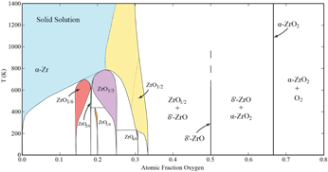
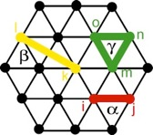


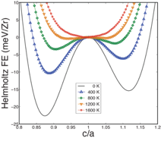
CASM: Statistical Mechanics (Faculty lead: Van der Ven)
First-principles
Electronic Structure
Features (*current public release)
  Symmetry analysis*
  Automated DFT job submission*
  Convex hull*
  Cluster expansions*, phonons, anharmonic lattice dynamics
  Monte Carlo simulation
Algorithmic construction of effective Hamiltonian
Configurational
Cluster Expansion
Phonon Hamiltonian
Anharmonic vibrational
Cluster Expansion
(kinetic) Monte Carlo

Slide 29
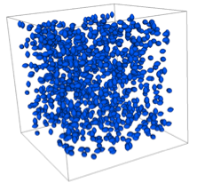
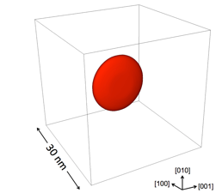
PRISMS-PF (Phase Field)
Open-source finite element phase field software:
  Matrix-free approach allows billions of DOF
  Arbitrarily high order spectral elements
  Near-ideal scaling for hundreds/thousands of cores
  4x faster than finite difference for Allen-Cahn test problem
Available physics:
  Cahn-Hilliard dynamics (for conserved quantities)
  Allen-Cahn dynamics (for non-conserved quantities)
  Mechanics
Target applications:
  Precipitate evolution
    Heterogeneous mechanical properties
    Composition-dependent misfit strain
    Nucleation & adaptive mesh/element order*
  Grain growth and recrystallization*
Simulation with 1,000 elliptical precipitates (10⁸ DOF)
*Coming in August 2016 Release
β’’’ precipitate in Mg-Nd alloy

Slide 30
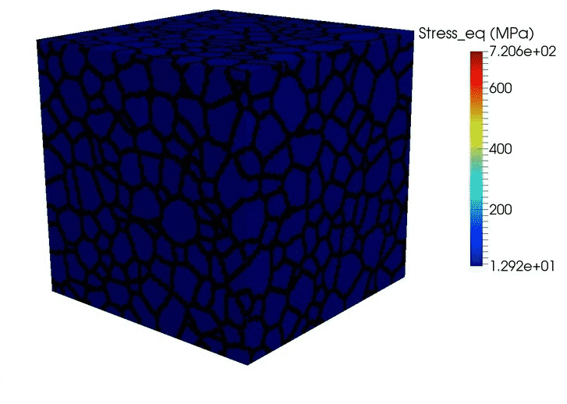
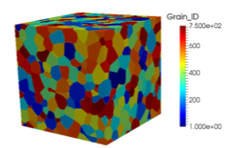
PRISMS-Plasticity (CPFE) (Faculty lead: Sundararaghavan)
  Features:
  Massively Parallel
  deal.II based
  Finite Strain
  Arbitrary boundary conditions
  Library of hardening laws:
Future releases:
  Kinematic Hardening
  Rate Dependence
  Dynamic Recrystallization
  UMAT format
CPFE simulation
Initial Microstructure
Representative Texture ODF
Weakly basal
(32*32*32 elements)=107811 DOF’s
Computational cost ~ 96 CPU Hours
200 time steps (~1000 solves)
750 grains (600*600*600 μm)

