Slide 1
Summer School for Integrated Computational Materials Education 2017
Overview of Computational Materials Science & Engineering:
What is it and how do we take advantage?
Katsuyo Thornton
Materials Science & Engineering
University of Michigan

Slide 2
Goals of This Overview
Introduce computational materials science and engineering (CMSE) to a broader audience
Encourage materials scientists and engineers to explore CMSE
Provide pointers for getting started
Notes:
The goal of today’s discussion is to first introduce you to the field of computational materials science and engineering, CMSE for short. Second, I hope to encourage you to explore possible options in utilizing this powerful technique whatever work you do. Finally, I will try to provide a pointer as to how you can get started in this exploration.

Slide 3
Outline
Why Computational Approaches?
What is Computational Materials Science and Engineering (CMSE)?
Computational MSE Tools of Today
How & Where to Start?
Conclusion
Notes:
So the talk is roughly divided into four parts. First is the general introduction to CMSE. The second is to go over the widely available CMSE tools of today. Third, I do want to give you a little glimpse of what’s being developed today in CMSE research, which are preview to what will be available in five to ten years. I will then wrap up the talk with the list of resources, etc.

Slide 4
1. Why Computation? Case of Mars Rover Curiosity
A.k.a. Mars Science Laboratory
Launched Nov. 2011; landed Aug. 5/6, 2012
Much larger/heavier than previous missions (weighs 1 ton!)
Many sensitive on-board tools, e.g., gas chromatograph, a mass spectrometer, a tunable laser spectrometer

Slide 5
Video

Slide 6
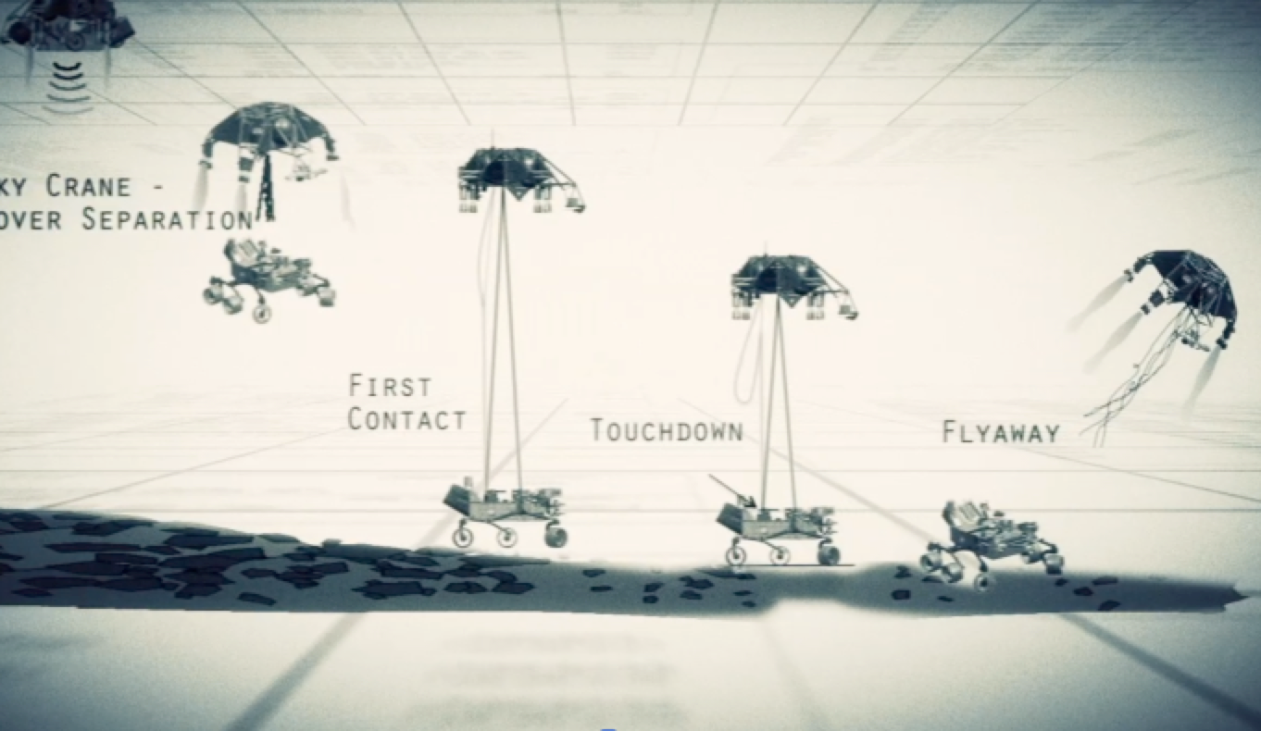
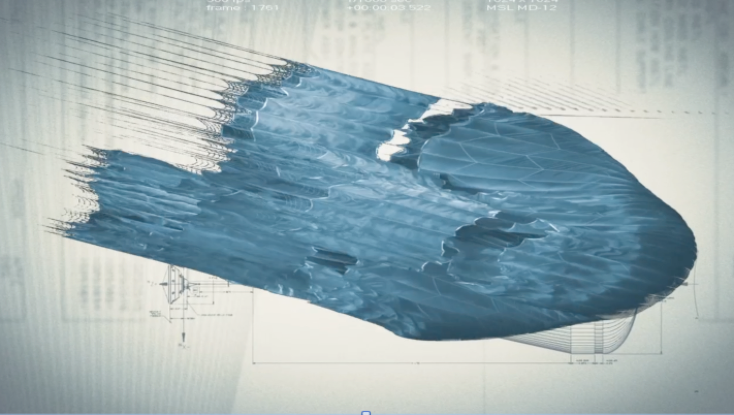
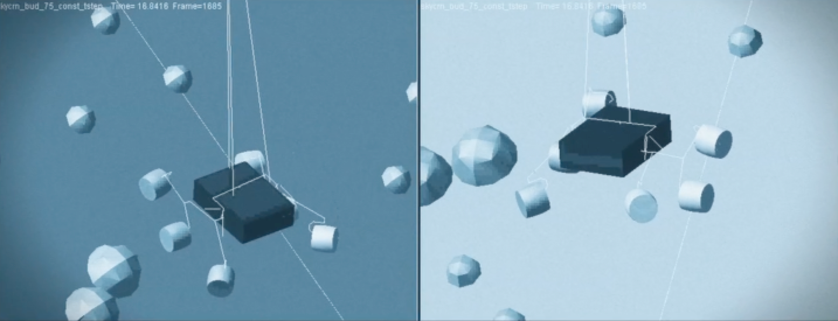
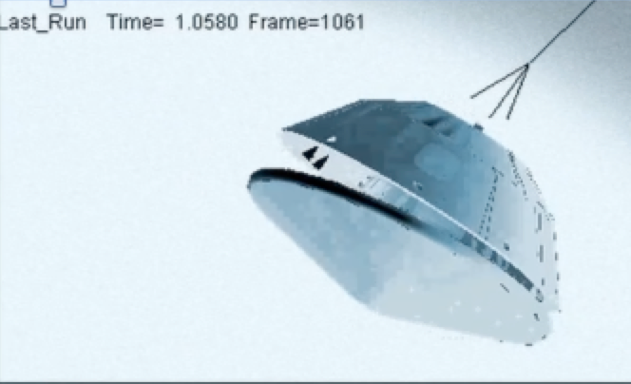
Simulations Played a Significant Role
Full testing is not possible on the Earth!

Slide 7
Enabler: Faster Computers
Computational power is growing exponentially!
Can do more complex calculations
Figure courtesy of Ray Kurzweil and Kurzweil Technologies, Inc.
Notes:
So, the problem can seem intractable. However, as I mentioned earlier, computational resources are increasing every year. This plot shows how calculation per second per $1000 has been increasing over the decades. The integrated circuit era is this last part. Note the log scale along the calculation axis, and therefore, the improvement is exponential. In fact, as predicted by Gordon Moore in 1965, the computational power in terms of number of transistor on an IC has been doubling every 2 years, which translates to faster computers. This allows us to do more complex calculations even over a short time of 5-10 years.

Slide 8
2. What is Computational MSE?
Materials are governed by their underlying physics
Their complexity often requires modeling and simulation
  Modeling: determination of important physics
  Simulation: prediction based on the model
Computational MSE: studies of materials by modeling and simulations
Notes:
So, the first part: what is CMSE? The way we approach the materials problem is to try to identify the governing physics of the materials system of interest, and try to predict how it behaves under the condition of interest, say under stress, heat treatment, etc. The problem is that the physics of materials is quite complex. So, we need to do not only modeling (identification of the important physics), but also do simulation to actually see what the model would predict. This means that we need to combine materials science and computational techniques to solve the problem. This discipline, called computational materials science and engineering, is therefore quite different from the traditional MSE field where experiments and analysis of the results drives the advancement.

Slide 9
Why Computational Materials Science?
Versatility; same method can be applied to many problems
Increasing computational resources; many more problems can be solved
Physical insights and understanding; applications beyond what is studied
How?
Develop a model of a materials system/process by identifying the underlying physics; solve the corresponding partial differential equations.

Slide 10
Early Adopters of Computation
Physics
Astrophysics
Mechanical Engineering
Chemical Engineering
…..
MSE is well behind these disciplines… Why? Early adopters have simpler governing physics, single scale, lack of experiments (astrophysics), etc.
Notes:
Computational science is not a new field. It has been commonly applied in physics, astrophysics, mechanical engineering, chemical engineering, etc. Computational approaches have been applied for decades, even when computational resources were limited. MSE was well behind in taking this approach, because of the fact that the governing physics of materials are quite complicated. On the other hand, many of these early adopters have much simpler physics (for example, mechanical engineers often focus on continuum mechanics). In other fields such as astrophysics, it is actually difficult to do experiments to gain insights. Therefore, MSE has always been dominated by experiments compared to theory, and simulation is affected by this trend as well. So this is the bad news, but there is also a good news. The computational resources are ready to accommodate the complex needs of MSE, and many computational techniques have been developed in various fields to be adopted for MSE problems.

Slide 11
Materials Science is Multiscale
Processes at large scale are governed by small scale phenomena
Often no simple links exist
Figure: J. Allison et al., JOM November 2006
Makes materials science difficult!
Notes:
So, why is MSE so complex? It is because MSE is multiscale. To illustrate this, I took an example from automotive engine. This figure comes from John Allison’s…. What we really want to understand is how materials behave at the device scale, which if often quite large. In this example, the questions are how an engine block performs, how long it lasts under the heat cycling it goes through during operation, etc.. That means that you must understand the stress and fatigue. But this depends on the phenomena occurring at many different length scales. In many systems, the grain structures are important, as well as porosity. Each grain is made up of multiple phases, and that means that properties also depend on the micro or nano structures, that can be controlled by adjusting processing conditions. Even smaller, there are individual atoms that makes up all these structures at larger scale, and that affects the behavior of materials at larger length scales, so it is important that we understand how they affect the materials behavior.

Slide 12
Moore’s Law
Transistor density doubles every ~2 years
Expected to hold to 2017 (10 nm width)
Figure courtesy of Ray Kurzweil and Kurzweil Technologies, Inc.
Notes:
So, the problem can seem intractable. However, as I mentioned earlier, computational resources are increasing every year. This plot shows how calculation per second per $1000 has been increasing over the decades. The integrated circuit era is this last part. Note the log scale along the calculation axis, and therefore, the improvement is exponential. In fact, as predicted by Gordon Moore in 1965, the computational power in terms of number of transistor on an IC has been doubling every 2 years, which translates to faster computers. This allows us to do more complex calculations even over a short time of 5-10 years.

Slide 13
Overview of CMSE
Continuum-level models
Continuum-level models
(at microstructural scale)
Meso-scale models
(dislocations in plasticity, etc.)
FEM/FDM
simulations:
-flow
-mechanics
Atomic-scale models
(atomic structure, dynamics)
FEM/FDM
simulations:
-grain growth
Phase equilibrium
FEM/FDM
-solidification
-processing
Phase equilibrium
FEM/FDM
-solidification
-processing
Phase equilibrium
FEM/FDM
-processing
Figure based on: J. Allison et al., JOM November 2006
MD
Ab initio
Notes:
So, now I’d like to give you an overview of CMSE. As mentioned, MSE is a multiscale subject. Which means that different governing physics must be considered depending not only on the system, but also the length scale of interest. This means that different computational techniques must be applied at different scales also. Here is a partial list of what types of computational techniques are available and what it can calculate. In continuum-level models, partial differential equations describing the behavior of the material are solved. At the largest scale, this may be the finite element method to solve for the flow during casting or mechanical strain due to heat cycling. At the smaller scale, you can study grain growth during solidification, or formation of microstructure during processing. At smaller scales, you may have to treat dislocations as discrete entity, or even keep track of individual atoms. Each of today’s CMSE models typically focus on one of these areas. Next, I will give you the brief description of what these tools are.

Slide 14
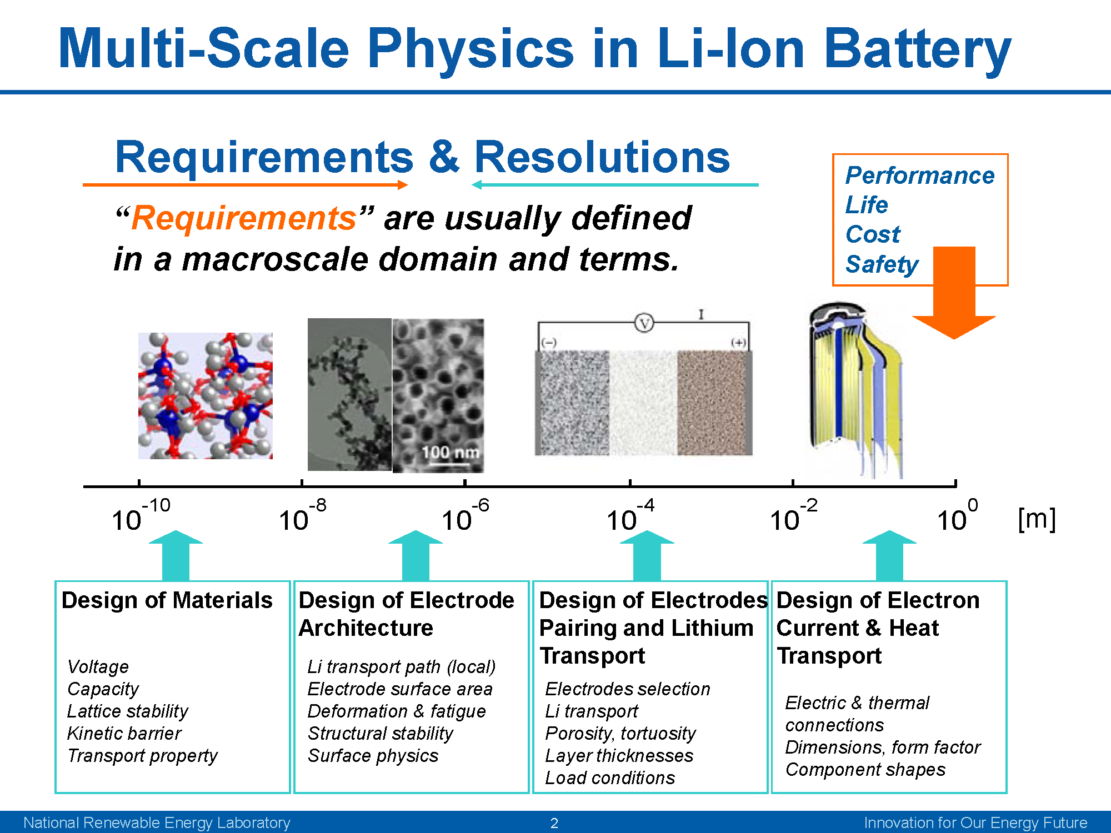
Parallel in Many Problems!
From Gi-Heon Kim and Kandler Smith, National Renewable Energy Laboratory

Slide 15
2. Today’s CMSE Tools and Applications
What tools are available?
What can they do?
How do they do it?
What are example applications?
We’ll go from the large scale to small
Notes:
So, this is the second part of my talk -- today’s CMSE tools and applications. We have quite a limited time, so I will not be able to go into a detail, but basically I hope to cover the following items: what tools are available, what they can do, how they do it, followed by example applications. We’ll go from the large scale to the small.

Slide 16
Continuum-Level Modeling
The behavior of materials at this level is described by a set of partial differential equations (PDE)
The state of the system is given by the solution of the PDE as a function of time and position
Examples: the displacement field U(x,y,z) for mechanical equilibrium, motion of interfaces due to diffusion
Notes:
At a larger scale, you can extract the behavior of atoms as collective entity, and describe the behavior by partial differential equations based on the governing physics. The state of the system can then be described by the solution of the PDE. For example, mechanical equilibrium is a simple statement that the sum of all forces and the sum of all torques are zero everywhere, such that there is no acceleration in any parts of the body. The state of the system in this case can be the displacement field as a function of spatial coordinates. The solution can also be dynamic, or depend on time, as in the case of motion of interfaces due to diffusion. This type of models can applied at a wide range of length scales, from macroscale to microstructural scales, and sometimes at nanoscale.

Slide 17
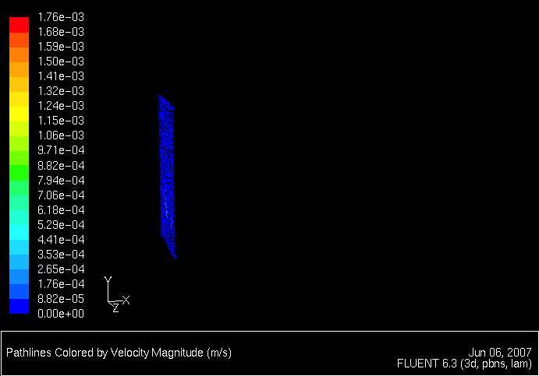
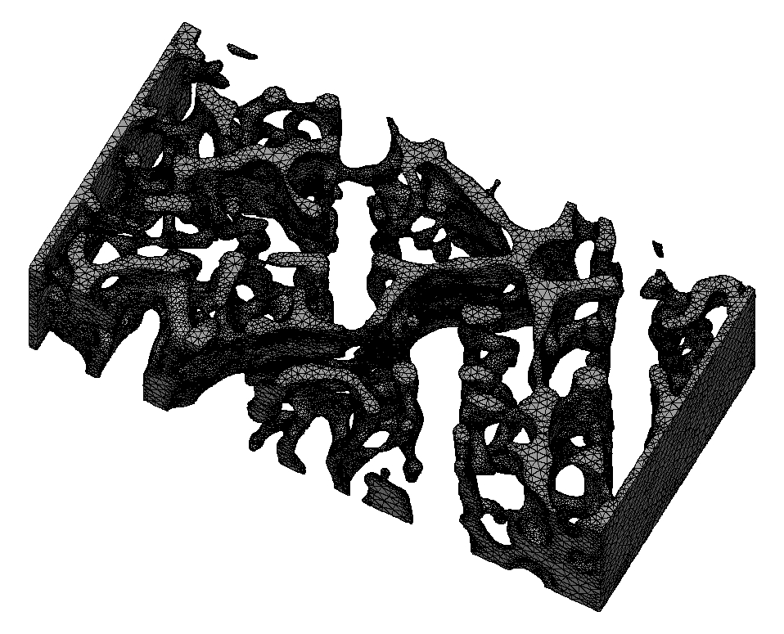
Finite Element Method (FEM)
FEM is widely applied to solve mechanical equilibrium and dynamics, fluid dynamics, etc.
Mechanics is often examined in MSE, but transport is also important (batteries, fuel cells, fluid flow during casting, etc.)
Both commercial and free codes are available and well developed
Alternative: Finite difference method (FDM)
Flow through a microstructure (calculation by Kim, Voorhees, and Thornton)
Notes:
Finite element method is a technique originally developed in other fields such as mechanical engineering, but are now finding applications in other fields including MSE also. This is one of the methods available to solve partial differential equations. It is widely applied to mechanical equilibrium and dynamics, fluid dynamics, and other problems. In MSE, mechanics is one of the dominant application of this, but also in other applications, such as transport have been examined, for example, transport in battery or fuel cell microstructures or fluid flow during castings. Both commercial and free codes are available and well developed. I should mention however, that there other other methods, such as finite difference method that also allows you to obtain solutions to PDEs.

Slide 18
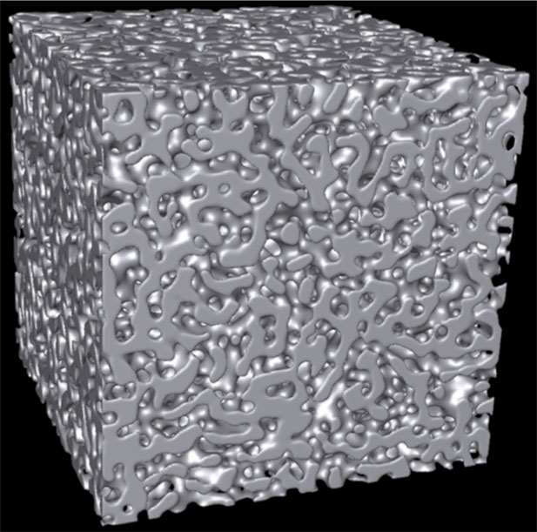
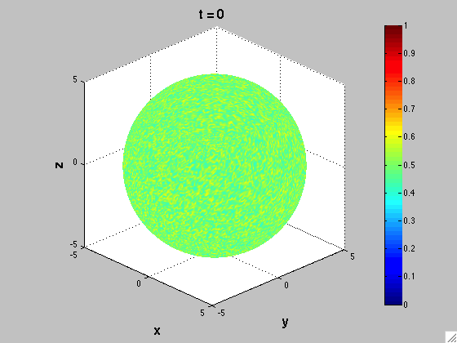
Other Continuum Simulations
Diffusion kinetics
  Solve diffusion equation
Phase-field simulations
  Multiphase systems are simulated by a spatially varying function
  Spinodal decomposition, growth and coarsening of precipitates, solidification
Simulation by Kwon, Thornton & Voorhees
Simulation by Funkhouser, Solis & Thornton
Notes:
Other types of continuum simulations include those that examine diffusion kinetics by solving diffusion equations, and phase-field simulations. Phase-field simulations are appropriate for studies involving multiple phases. It represents different phases by a spatially varying function, and it can model spinodal decomposition, growth and coarsening of precipitates, and solidification, among others.

Slide 19
Mesoscale Modeling
Modeling of phenomena at the intermediate scale
Examples: Plastic deformation modeled by dislocation dynamics (DD), where each dislocation is treated as a discrete entity and interacts with stress field; Brownian dynamics (BD) of macromolecules
Simulated dislocation structure for nano-indentation
From 3D Discrete Dislocation Dynamics (3D4) website
Notes:
At a smaller scales, you may have to treat some aggregate or structural features (such as defects) as individual entity. The definition of mesoscale modeling can vary somewhat, but here I use the definition where some type of discreteness is included in the models. Examples include dislocation dynamics which tracks the motion of each dislocation, as well as the Brownian dynamics which tracks the motion of molecules, such as polymers, as a individual entity. These are distinguished from atomistic models because they do not actually examine the individual atoms.

Slide 20
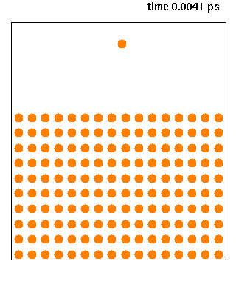
Molecular Dynamics
Keep track of atomic positions
Calculate forces on atoms based on atomic interaction potential
Update the atomic positions by Newton’s Law: F = ma
Computationally intensive; must resolve the atomic vibration in time -- time step ~ fs
http://mrflip.com/resources/MDPackages.html for a list
An MD simulation of deposition of a single copper atom on a copper surface. A cross section of a 3D cell is shown. (From Wikipedia Commons)
Notes:
At the smaller scale, you can apply molecular dynamics, where one keeps track of individual atom’s positions. In this case, you can calculate the force on each atom based on the prescribed interaction potential, and update the position and velocity of it over a small time interval. The drawback of this approach is that not only the size scale is limited due to the fact that each individual atom must be examined, but also the fact that the atomic vibration must be resolved. As you can see in the animation, the atoms tend to move back and forth between the equilibrium position, so you may have to wait for a long time to observe something interesting.

Slide 21
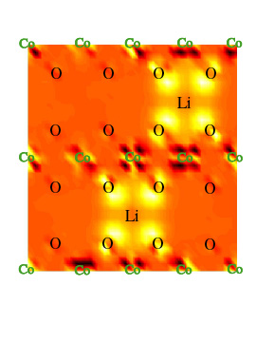
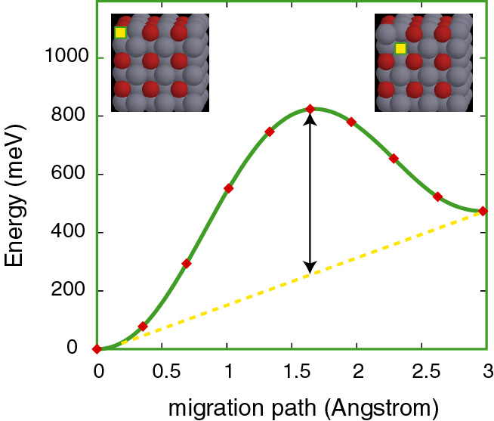
Quantum Mechanical Calculations
Often referred to as ab initio
Density Functional Theory (DFT): Solves Schrödinger's equation approximately for charge density
Length scale limited; equilibrium calculations in most part
Can accurately predict phase stabilities, atomic interaction potentials, surface energies, etc., which can then be used for larger scale modeling
http://www.psi-k.org/codes.shtml
Courtesy of A. Van der Ven,
University of Michigan
Notes:
Of course, the atomic interactions are actually governed by quantum mechanics that describes the interacting wavefunctions of particles that comprise the atoms. While it is too challenging to solve for the interacting wavefunctions, there are well developed scheme to solve for the electron charge distributions. This provides a method to computationally predict material properties from the fundamental physics (with small approximations). While the length scale that can be considered may be small, it provides important information of equilibrium properties of materials, such as phase stabilities, atomic interaction potentials, surface energies, etc. The top picture show how the charge preferentially collect around Li in an intercalation compound. The bottom show how the atomic migration barrier is calculated from the system’s energy variation as an atom migrate from one site to anther. The list of software is avaialbe at…

Slide 22
Computational Thermodynamics (Database-Based)
One of the most widely applied MSE-specific methods
Based on databases (either obtained by experiments or ab initio calculations), calculate phase diagrams, phase fractions, etc.
Computation is needed for flexibility of having many components and interpolating/extrapolating the available data
Notes:
Last, but may be the most widely applied MSE specific computational method is the thermodynamics calculations based on databases. Using information extracted from experiments or ab initio/quantum calculation, one can obtain the phase diagrams, and other information. Here, computation is needed to provide the flexibility to model real systems made of many components and obtain new data by extrapolation.

Slide 23
Equilibrium Phase Calculation Example
A phase diagrams for ternary system (W-Co-C)
Method: CALPHAD (CALculation of PHAse Diagrams)
Quality of the database determines the accuracy of the prediction
Vertical section (isopleth) of the tungsten-cobalt-carbon (W-Co-C) ternary system, calculated with Thermo-Calc coupled with SSOL4 thermodynamic database. The cobalt content is kept constant at 10 wt. %. (From http://www.calphad.com/tungsten-cobalt-carbon.html)
Notes:
Here is one example of a phase diagram calculated for a ternary system (tungston-cobolt-carbon). The method is called Calphad, from calculation of phase diagram), and as I will mention, there are many commercial programs and databases to do such calculations. Since the results depend on the database, it is important to note that the accuracy of the prediction depends on the quality of the database.

Slide 24
4. How Do I Start?
Identify the problem and examine possible tools; start small (read success stories)
Obtain the software (+hardware)
  There may be simpler and more inexpensive options to start with
  Ask about demo or trial version of commercial software
  Free software (typically there is no technical support, however)
Follow tutorials; examine demo setup
For commercial software, sign up for training
Alternatively, try nanohub, etc., where simulations can be run over the web.
Notes:
So, now you may have some idea where to get some information. But how do you get started? The most important and probably the most difficult part of the starting process is the identification of the problem to examine. I suggest one starts small, and use success stories which are often featured in software’s web pages to identify what is doable. Second step is to obtain the software, and if necessary the hardware. CONTINUE

Slide 25
Beyond Free/Commercial Software
Matlab or other high-level programming languages/scripts
  If the problem is simple enough, it can be solved using easy-to-learn programming languages and scripts
Fortran, C, C++
  These languages provide computational efficiency, but more difficult to learn
  Utilize libraries when possible
Notes:
Depending on your applications, it may not be quite possible to simply apply the existing tools, although I believe starting small and solving the easier problems first will have impact that one can build upon. But if you are ready to attack more difficult problems, it may be best to start discussions with experts. Often professors are available for technical consulting. The most difficult part is to identify who to talk to. I would first start with local university, and once you get to someone who is familiar enough, that person may be able to suggest other names of experts in the specific area. Most research universities have well developed corporate relations department either under the engineering college or school or at the university level, which maintains a list of experts. Discussion may lead to new proposals, as there are opportunities set aside for interactions between industry and academia, for example. Of course, you may find other collaboration opportunities beyond computational aspects, including instrumental usage or advice on experimental work.
GRANT OPPORTUNITIES FOR ACADEMIC LIAISON WITH INDUSTRY

Slide 26
5. Conclusion/Takeaway
Many simulation tools are now available for immediate applications
Applications at various levels; training and support available for commercial packages
Simulation tools can save time and resources required for materials and component design
Take advantage of exponentially increasing computational power!
Notes:
In conclusion, I hope I have convinced you that there are many simulation tools that are ready to be exploited. These applications can be applied at various levels, and for commercial packages, there are extensive training and support structure. While there wasn’t time to make the case, I have give you pointers to resources demonstrating the fact that simulation tools can save time and resources required for materials and component design. And finally, I hope that many of you will use some of the starting points I’ve outlined and begin taking advantage of the exponentially increasing computational power. Thank you for your attention!

Slide 27

Mars Rover Curiosity Update
As of May 17, 2017, Curiosity has been on Mars for 1745 days since landing on Aug. 3, 2012!
Mission extended indefinitely.
It will be the basis of the planned Mars 2020.

Slide 28
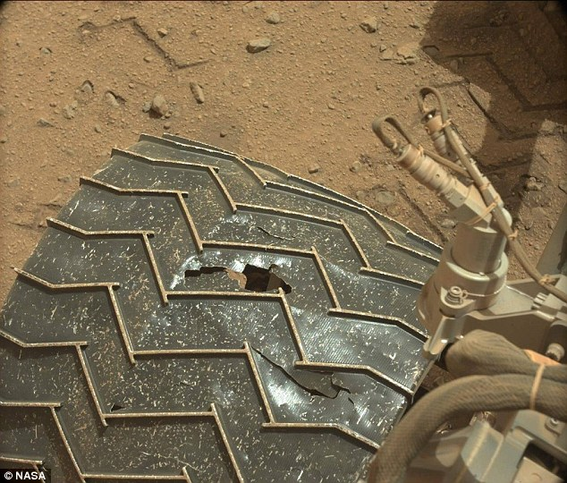
Mars Rover Tire Damage Identified in Summer 2014
Aluminum tires are showing damages
It’s still going --
~15 kilometers*
(~9.5 miles*) of
total driving since its 2012 landing!
But we need stronger Al for future missions!
*As of Jan. 2017

Slide 29
Mars Rover Tire Damage Identified in Summer 2014
Aluminum tires are showing damages
It’s still going --
~15 kilometers*
(~9.5 miles*) of
total driving since its 2012 landing!
But we need stronger Al for future missions!
Maybe one of you could solve the problem for Mars 2020!
*As of Jan. 2017

Slide 30
Questions?
5 min break

