Slide 1
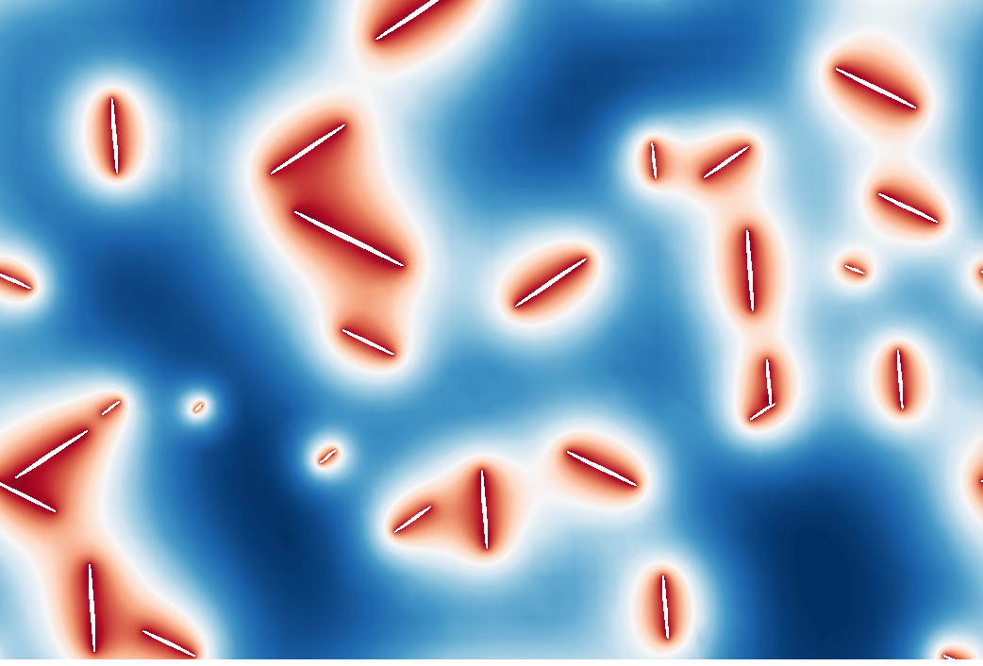
Lead Developer:
Stephen DeWitt
Contributors:
Shiva Rudraraju (U. Wisconsin), Larry Aagesen (INL), David Montiel, Beck Andrews, Katsuyo Thornton

Slide 2
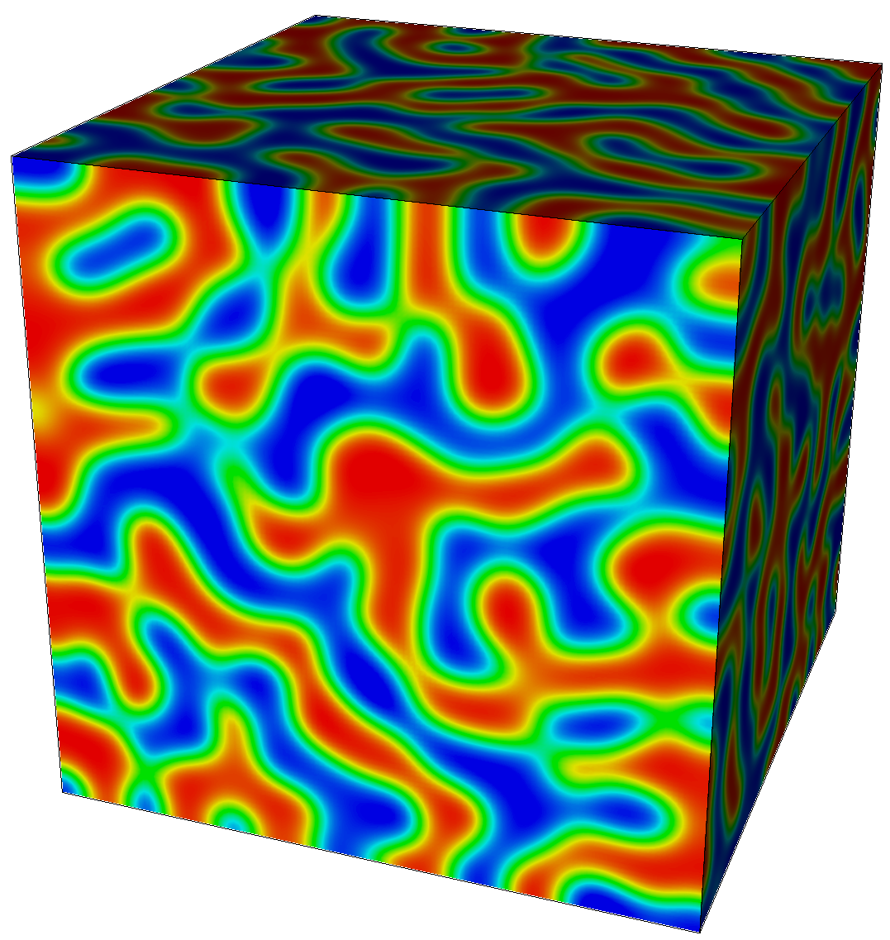
Background: Phase Field Modeling
Diffuse interface approach to modeling microstructure evolution
Used to study phase separation in systems with 2+ free energy minima
Evolution equations derived from a free energy functional
  May or may not have a physical basis
Applications include:
solidification, precipitation, grain growth, phase separation in batteries, deposition, ferroics
Allen-Cahn Equation
(non-conserved dynamics)
Cahn-Hilliard Equation
(conserved dynamics)
Spinodal Decomposition
(Cahn-Hilliard Equation)

Slide 3
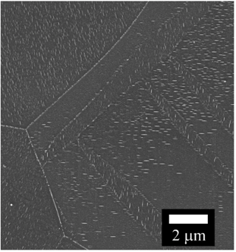
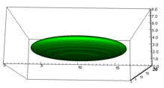
Motivation and Requirements for the PRISMS Phase Field Code
Microstructure simulations often require very large calculations
These are terascale computational problems with 10⁶ to 10⁹ DOF
For grain growth, need the ability to track 100s of grains
Many different governing equations fall under the umbrella of “phase field modeling”, need flexibility
Finite Element Method
  Easily allows mesh adaptivity, arbitrary geometries, and high order of accuracy
  Can build from well-established community codes (e.g. deal.II)
  Allows a shared toolset with PRISMS-Plasticity and PRISMS-RSDFT
  However, need a low memory approach to compete with finite difference
3

Slide 4
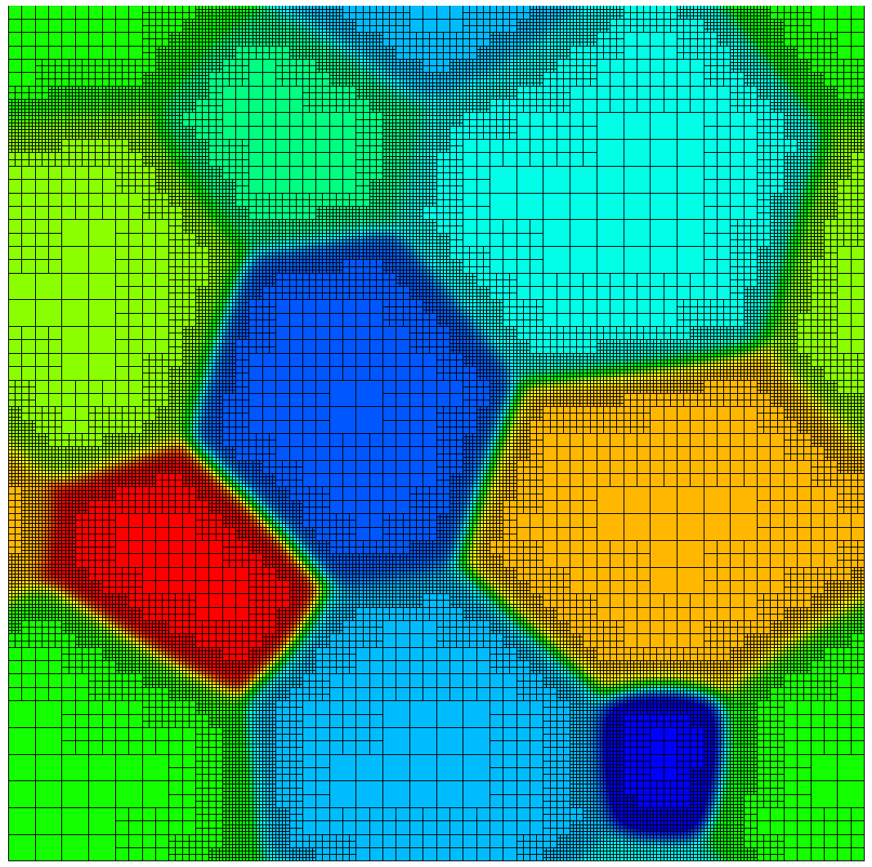
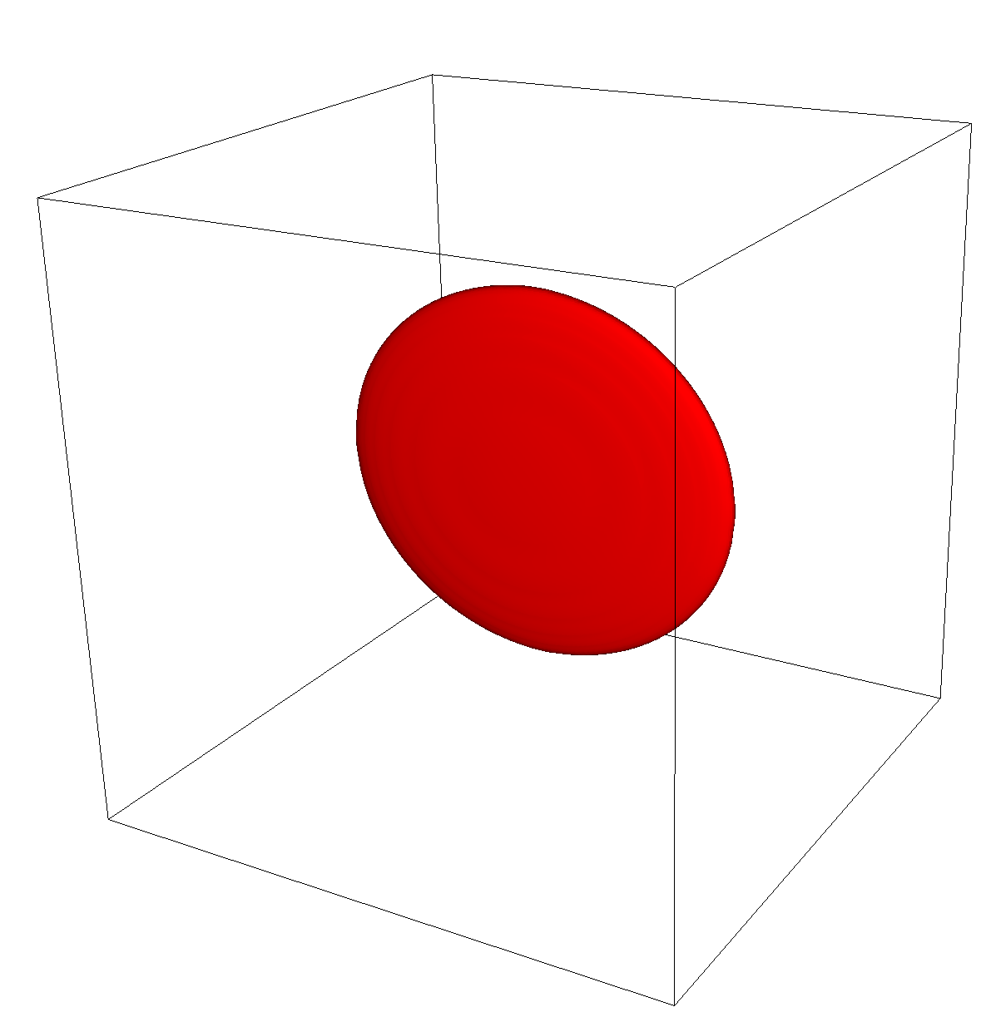
An Open Source, Finite Element,
General Purpose Phase-Field Platform
(github.com/prisms-center/phaseField)
User-Friendly:
Simple interface to solve an arbitrary number of coupled PDEs
Detailed user guide
22 applications to get you started
Simple Docker-based installation
High-Performance:
Matrix-free finite-element approach
Ideal scaling for >1,000 processors
Adaptive meshing
Competitive performance with finite difference (even without adaptive meshing)

Slide 5
Our Philosophy
Provide flexibility
  Phase field models have a wide variety of governing equations, initial conditions, boundary conditions, length scales, time scales
  We make it easy to develop/modify your own apps instead of providing a one-size-(doesn’t)-fit-all solution
Do simple things fast
  Complex numerical schemes aren’t always faster and can hurt usability/flexibility
  We focus on using the simplest performance-competitive methods with minimal overhead
Hide as much complexity as possible from the user
  Most users don’t need/want to know all the numerical details
  We hide the implementation details in the core library, so most users can focus on the problem that they’re trying to solve

Slide 6
Structure of PRISMS-PF
Core library
  Generates mesh, does the finite element calculation, outputs files, etc.
Apps
  Each app is a directory that contains (at least) three input files
    parameters.in: Numerical parameters, including meshing options, time step, etc.
    equations.h: Governing equations
    ICs_and_BCs.h: Initial conditions and boundary conditions
  Copy and paste an app directory to create a new app
Tests
  Suite of unit and regression tests

Slide 7
Three Types of PRISMS-PF Users
Uses PRISMS-PF applications
  No C++ knowledge needed
  No deal.II knowledge needed
Creates PRISMS-PF applications
  Minimal C++ knowledge needed
  No deal.II knowledge needed
Extends PRISMS-PF itself
  C++ knowledge needed
  deal.II knowledge needed

Slide 8
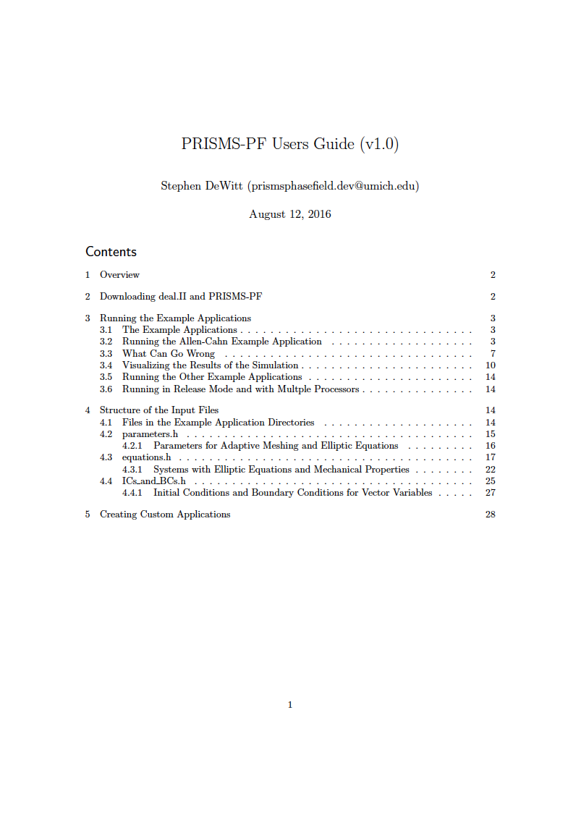
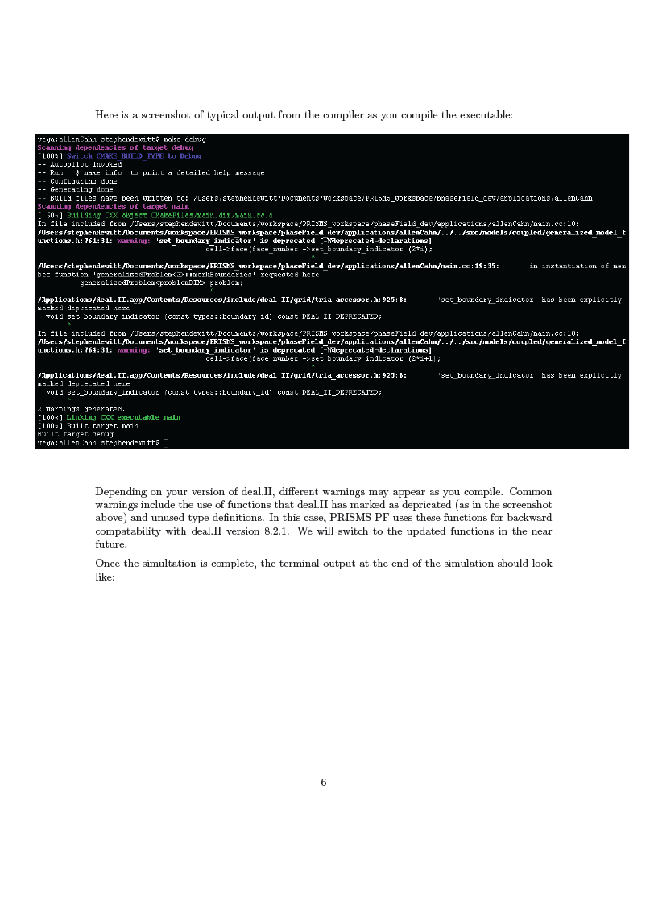
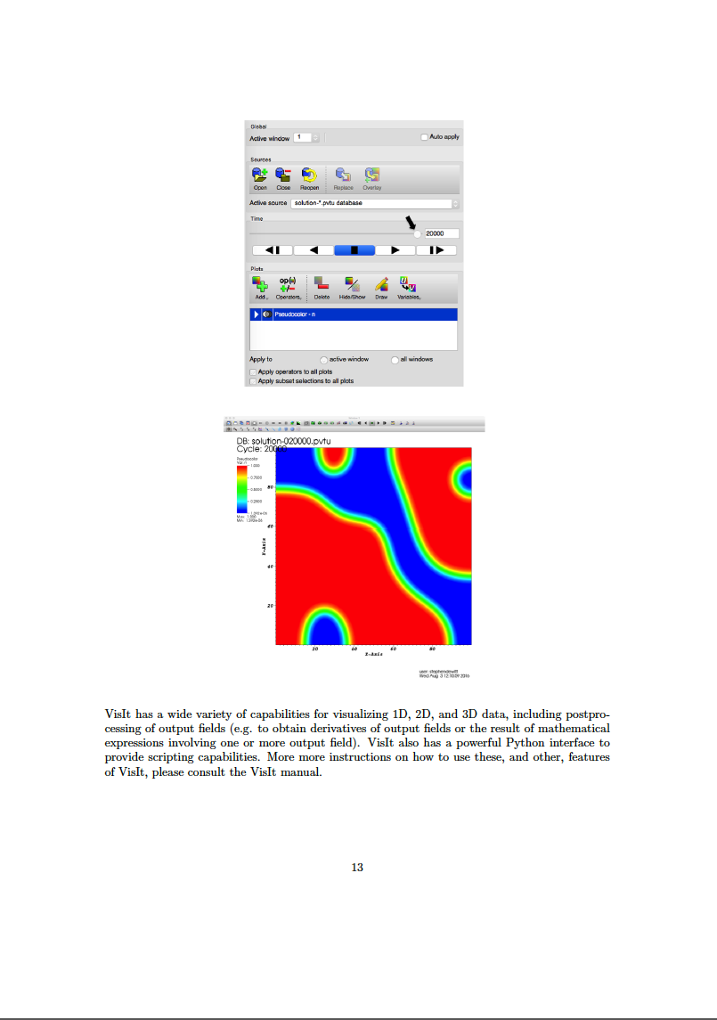
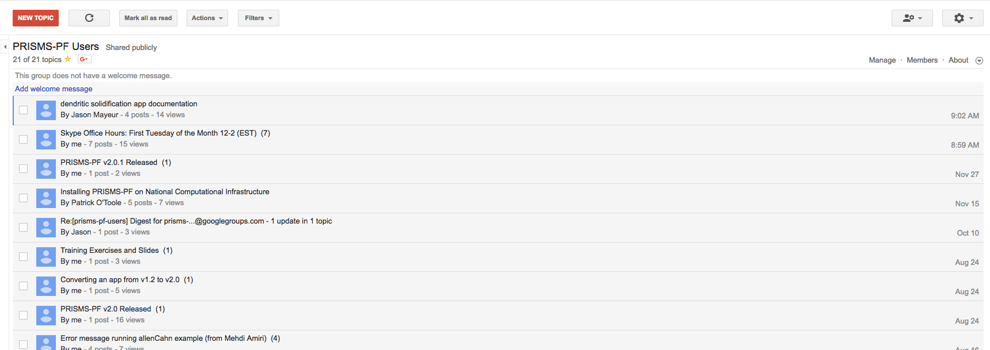

Community Support
User guide
Online forum
Monthly Skype office hours

Slide 9
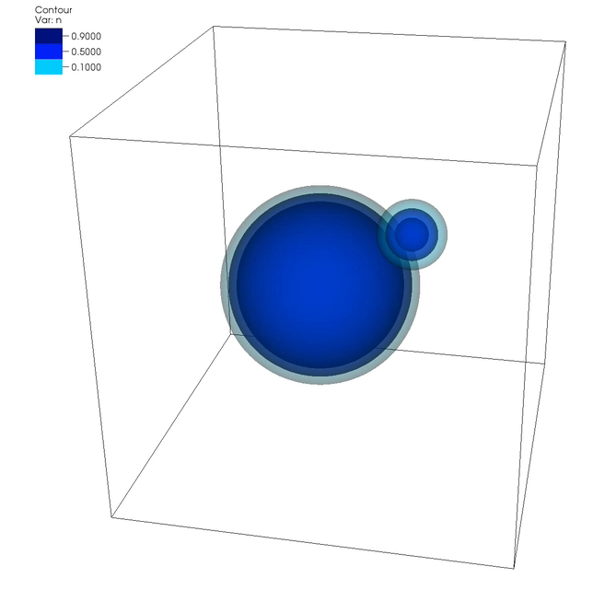
PRISMS-PF delivers improved performance over a custom finite difference code
Comparison code:
Custom finite difference code
Written in Fortran with MPI parallelization
Second order central differencing
Explicit time stepping (forward Euler)
6 pts. in
interface
3 pts. in
interface
Test Case: Ostwald Ripening
6.7x
Without mesh adaptivity: PRISMS-PF 1.6x faster
With mesh adaptivity: PRISMS-PF 6.7x faster

Slide 10


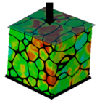
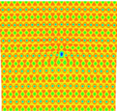


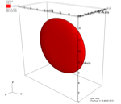
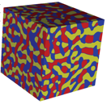

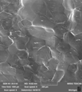
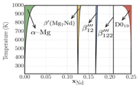

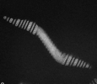
PRISMS Center Precipitate Use Case
Atomic scale
constitutive laws
Dislocation Dynamics
(LLNL-ParaDIS)
Crystal Plasticity
(PRISMS-Plasticity)
Real Space DFT
(PRISMS-RSDFT)
Statistical Mechanics
(CASM)
Continuum Plasticity
(PRISMS-Plasticity)
Phase Field
(PRISMS-PF)
Mechano-Chemistry
(PRISMS-MC*)
Fourier Space DFT
(VASP)
Phase Diagrams
(CASM/CALPHAD)
Experiments (slip,
twinning, crack, etc.)
Phase Field Crystal
(PRISMS-PFC*)
Experiments

Slide 11
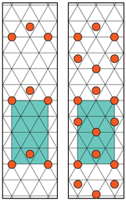
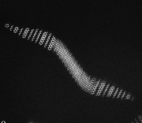
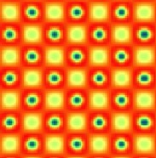
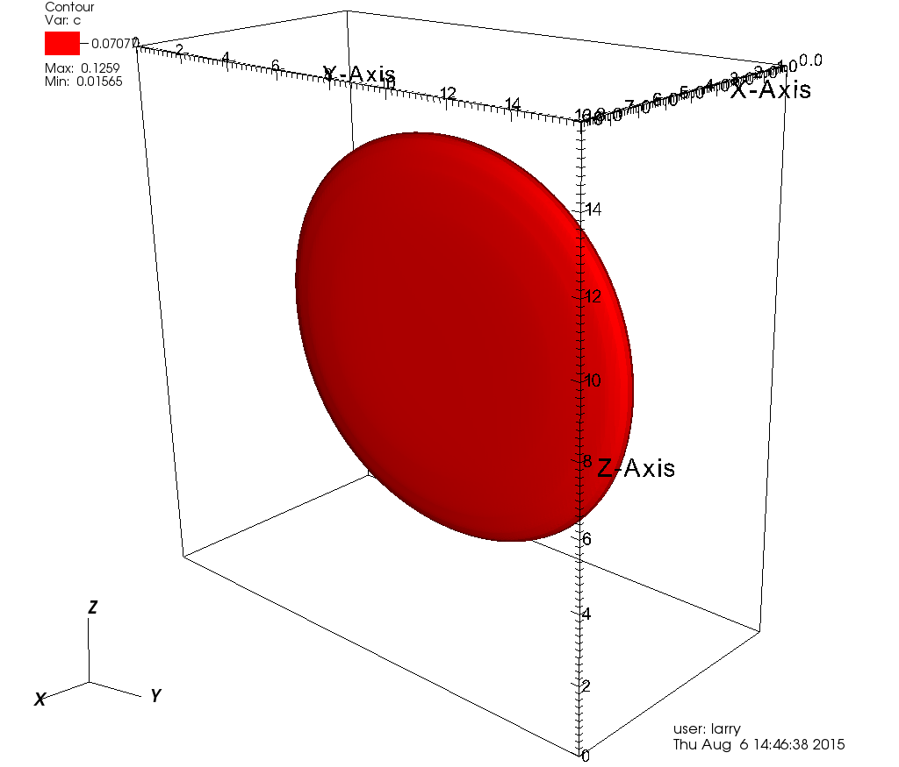
A comprehensive ICME approach to study precipitation in Mg-RE alloys
Inform problem space
Enumerate Configurations
Finite Temp. Energies
Statistical Mechanics
(CASM)
0K Energies
Precipitate Dimensions
(Validation)
Experiments
(HAADF-STEM)
Fourier Space DFT
(VASP)
Elastic Constants, Transformation Strains
Phase Field
(PRISMS-PF)
Synthetic Precipitate Microstructures
Yield Strength
(Validation)
Dislocation Dynamics
(LLNL-ParaDIS)
Experiments
(Tensile Tests)

Slide 12


Precipitates in Mg-RE Alloys
Mg alloys are of interest for lightweighting in automotive and aerospace applications
Mg-RE alloys, such as Mg-Nd and Mg-Y have among the best mechanical properties of Mg alloys
β’’’ precipitates with habit planes perpendicular to the basal plane block dislocation motion
Plots courtesy E. Deda, A. Githens (UM)
Schematics: J.F. Nie, Met. Trans. A, 43A, 3891 (2012)

Slide 13
Experimental Motivation: The Precipitation Sequence
GP
GP
β₁
β’’’
GP
β’’’
β’’’

Slide 14


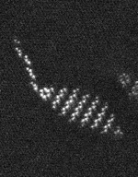
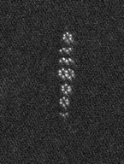
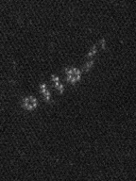
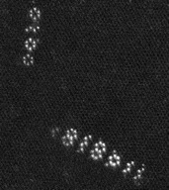
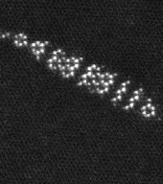
First-principles: Metastable hcp ground states
2 nm
2 nm
2 nm
2 nm
2 nm

Slide 15
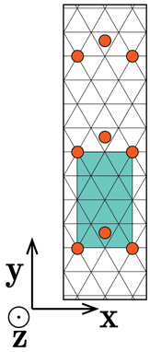


Why are the β’’’ orderings observed?

Slide 16
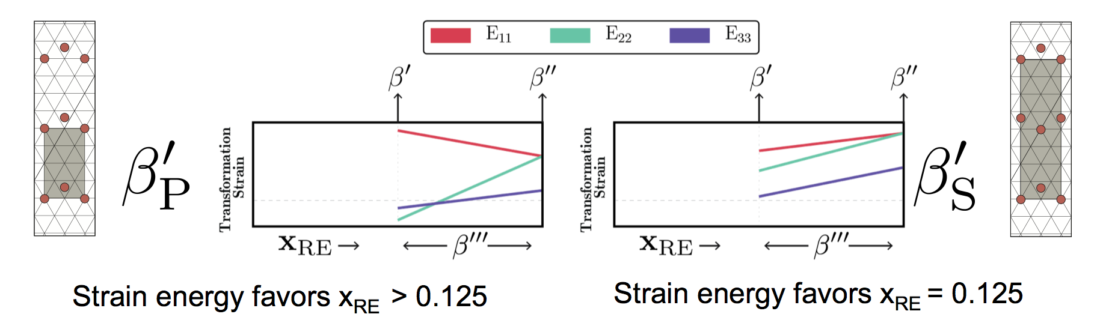
Background: Two types of β’/β’’’

Slide 17

Phase Field Model Can Calculate Equilibrium Shape and Composition
Use inputs from first principles calculations to predict Mg-Nd β’’’ shape and composition
No fitting parameters
Yields a lenticular precipitate

Slide 18
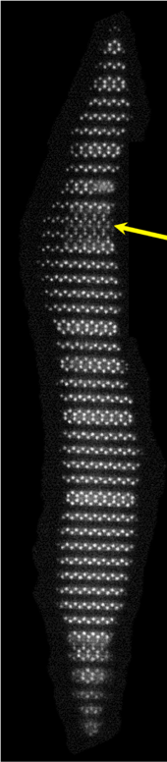
Simulated composition within experimental range, suggests β’’’ structure
β’’
Simulated composition 0.138–0.146 Nd
Notably elevated above β’ composition
Consistent with experimental range, 0.125–0.167 Nd
β’
Hex Row
Zig-zag Row
Alternating hexes and zig-zags would be 0.15 Nd
Notes:
Actual values: 0.146, 0.141, 0.140, 0.138
If hexes and Ns alternated, this is the <0^2 1> ordering, with composition of 0.15
Decreasing composition consistent with Gibbs-Thomson effect

Slide 19
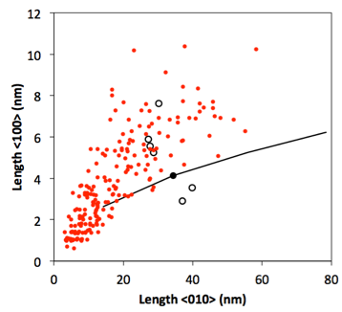
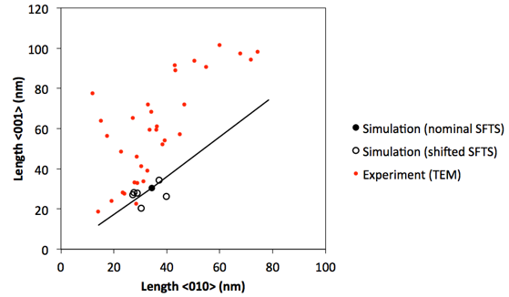
Quantitative Comparison to Experiments
Comparing predicted equilibrium dimensions to experimental dimensions, including the effect of uncertainty

Slide 20
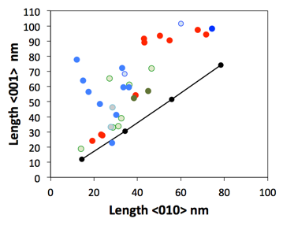
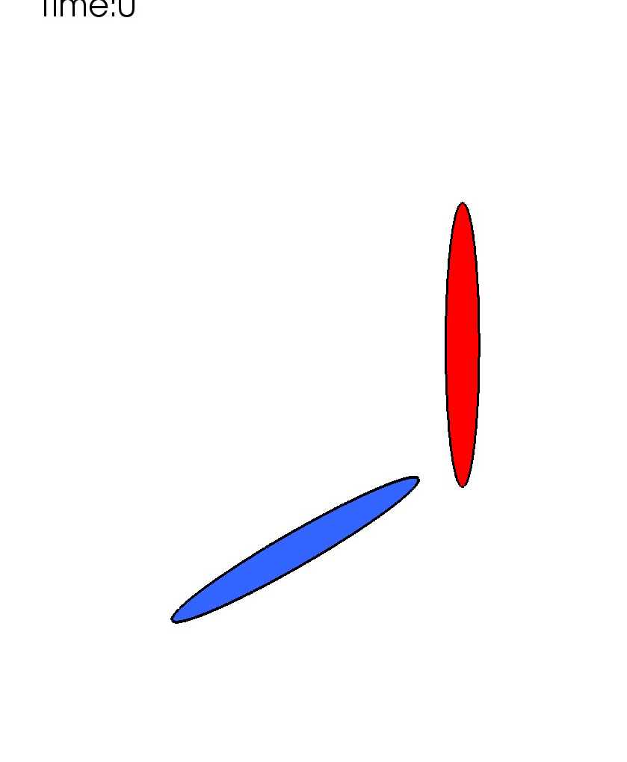
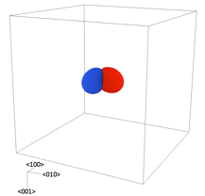
Non-Equilibrium Effects on Morphology
Simulation of two precipitates in this configuration demonstrates this mechanism:
Growth along <010> could be impeded by a neighboring precipitate of another variant
<010>
<100>

Slide 21
Simulated Mg-Nd β₁ Microstructure
To connect microstructure to strength, we need an entire precipitate microstructure
B1 precipitates after 9 hours of aging, 0.4 at. % Nd
2D simulations of β₁ precipitates in Mg-Nd
Explicit nucleation model based on classical nucleation theory
Need 3 constants for the nucleation rate
Courtesy of Zhihua Huang (UM)

Slide 22

Simulated Mg-Nd β₁ Microstructure
1.6 μm

Slide 23
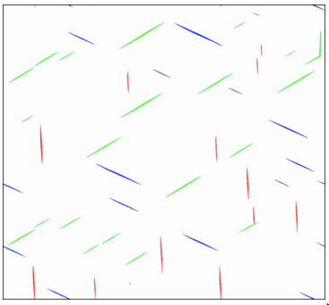
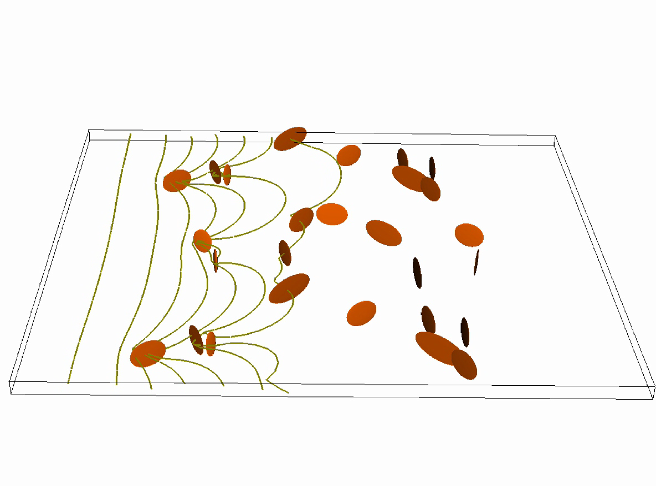
Simulated β₁ Microstructure: Going Forward
Quantitative Comparison vs. Experiment:
Simulations qualitatively agree with experiment, but needs quantitative analysis
  Volume fraction, number density, size distribution
May require an improved a priori model for matrix composition evolution
  KWN?
Connection to Dislocation Dynamics:
Use DD to determine the critical resolved shear stress required to pass dislocations through the precipitates

Slide 24
Summary: Precipitate Use Case
Example of the ICME methodology in action
Brings together first principles calculations, phase field simulations, dislocation dynamics simulations, and experiments
Obtain fundamental mechanistic understanding of the precipitates in Mg-RE alloys and a platform for microstructure and property prediction
Natarajan et al., On the early stages of precipitation in dilute Mg-Nd alloys, Acta Mater. 108 (2016).
Natarajan and van der Ven, A unified description of ordering in HCP Mg-RE alloys, Acta Mater. 124 (2017).
Solomon et al., Early precipitate morphologies in Mg-Nd-Zr alloys, Scripta Mater. 128 (2017)
DeWitt et al., Misfit-Driven β''' Precipitate Composition and Morphology in Mg-Nd Alloys, Acta Mater. 136 (2017).

Slide 25



Using PRISMS-CPFE to model microstructural influences on tensile Deformation in HCP Metals
Sriram Ganesan¹, Veera Sundararaghavan¹ , Mohammadreza Yaghoobi²
Contributors : Alan Githens², Zhe Chen³,Samantha Daly^{,3}, John Allison²
¹Department of Aerospace Engineering
²Department of Materials Science and Engineering
University of Michigan
³ Department of Mechanical Engineering
University of California-Santa Barbara
Center for PRedictive Integrated
Structural Materials Science

Slide 26
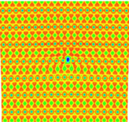
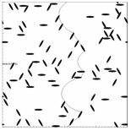
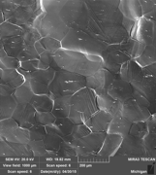


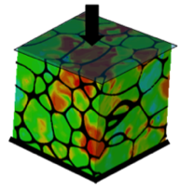

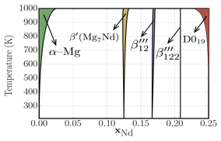
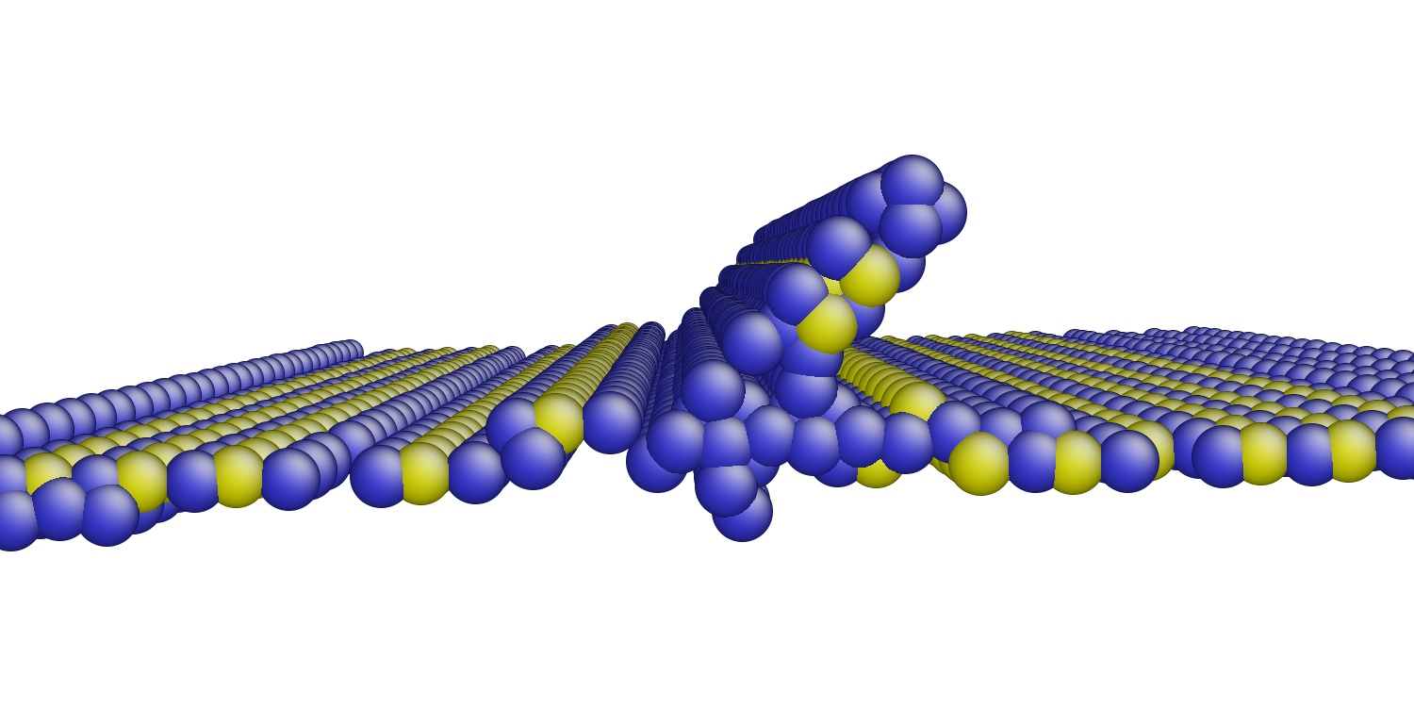
PRISMS Center Integrated Framework
Enabling accelerated predictive materials science
Real Space DFT
DFT-FE
Dislocation Dynamics
LLNL-ParaDIS
EXPERIMENTS (slip,
twinning, crack, etc.)
Statistical Mechanics
CASM
Fourier Space DFT
(e.g. VASP)
Continuum Plasticity
PRISMS-Plasticity
Phase Field
PRISMS-PF
Crystal Plasticity
PRISMS-Plasticity
Phase Diagrams
CASM/CALPHAD
EXPERIMENTS
(TEM, APT)
Atomistic
LAMMPS

Slide 27
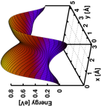
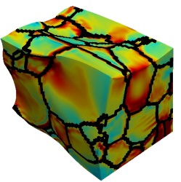
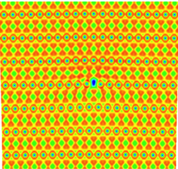
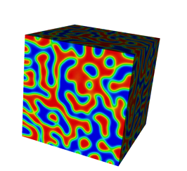
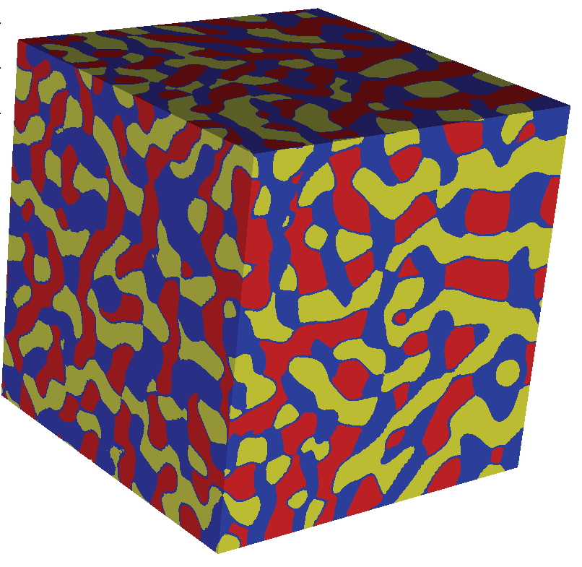
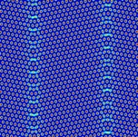
PRISMS Center Integrated Framework
Enabling accelerated predictive materials science
Atomic scale
constitutive laws
Dislocation Dynamics
LLNL-ParaDIS
Crystal Plasticity
PRISMS-Plasticity
Real Space DFT
PRISMS-RSDFT
Statistical Mechanics
CASM
Continuum Plasticity
PRISMS-Plasticity
Phase Field
PRISMS-PF
Mechano-Chemistry
PRISMS-MC*
Fourier Space DFT
(e.g. VASP)
Phase Diagrams
CASM/CALPHAD
EXPERIMENTS (slip,
twinning, crack, etc.)
Phase Field Crystal
PRISMS-PFC*
EXPERIMENTS(nucleation
kinetics, etc.)

Slide 28
Crystal plasticity finite element
resolution for dislocation plasticity.
Atomistic
Discrete
dislocations
Dislocation
patterns
Grains
Macroscale
Molecular
Dynamics
Discrete Dislocation
Theory
Continuously
Distributed
Dislocation Theory
Crystal Plasticity
Continuum Plasticity
Polycrystal idealizations (grains with distributed defects – dislocations).
Both scales of
grain and sub-grain
structures
Grain scale
heterogeneities
Homogenized
description
ftp://ftp.wiley.com/public/sci_tech_med/icme_metals

Slide 29
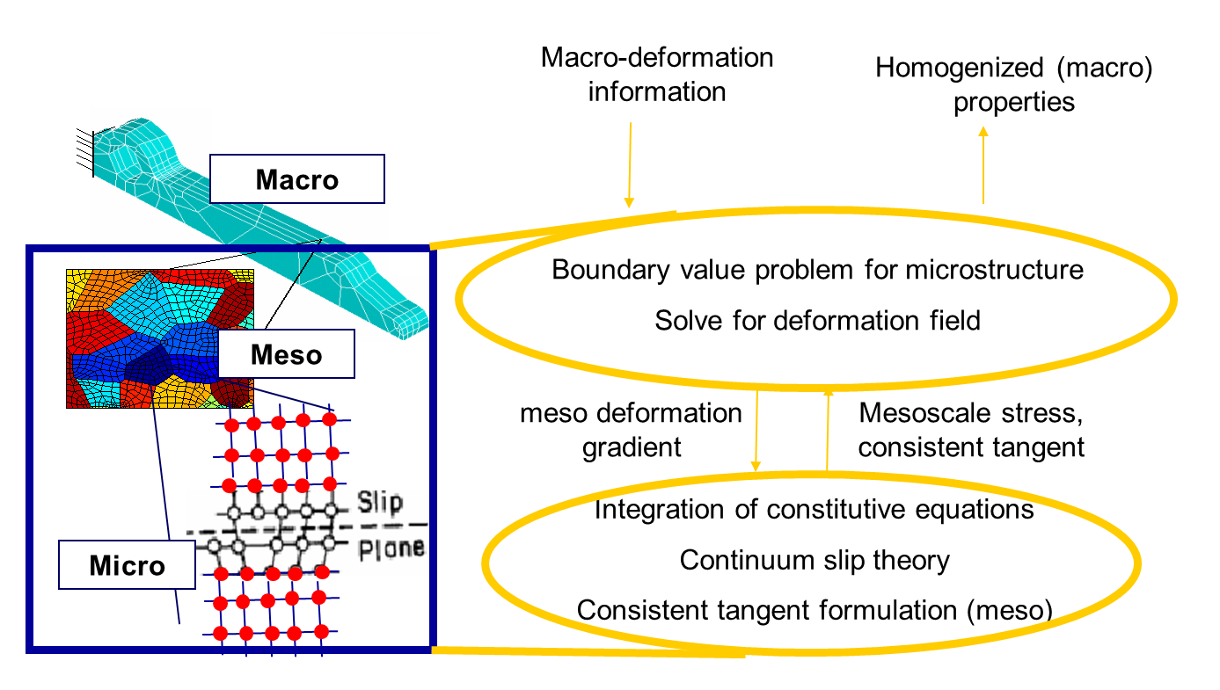
PRISMS CPFE

Slide 30






PRISMS CPFE Code
Code highlights:
  Parallel 3D crystal plasticity models implemented over Elliptic PDE base class
  Support for reading external microstructures post-processing capabilities (pole figures, orientation distribution functions, etc)
  Demonstrates parallel performance and scaling on large-scale problems running on hundreds of processors.
  Training at the PRISMS Workshop
ODF ε=0
ODF ε=-0.25
Virtual Microstructure - Neper
Visualization - Paraview
Pole Figures -MTex

Slide 31

PRISMS CPFE Code: User’s Guide
Instructions for downloading and installing PRISMS-CPFEM and pre-requisites
The theory behind the PRISMS-CPFEM
Description of the some examples exist in the code application folder

Slide 32


Crystal plasticity: Single crystal model
Elasto-plastic decomposition of deformation gradient
Stress-strain relation (Hooke’s law)
Plastic Flow rule
Shearing rate (RD)/Yield Surface (RI)
Hardening laws

Slide 33
Magnesium alloys – modeling slip and twinning

Slide 34

Slip and Twin systems in WE43 alloy

Slide 35






Virtual Tensile testing using CPFE
Mode | τ₀^{α} (MPa) | h₀ (MPa) | τ_{sat} (MPa) | a
Basal <a> | 47.6 | 595 | 144.4 | 2.5
Prism <a> | 92.2 | 412 | 289.0 | 2.5
Pyram <a> | 104.5 | 373 | 347.5 | 2.5
Pyram<c+a> | 117.3 | 321 | 304.9 | 2.5
Twin<c+a> | 84.4 | 419 | 148.8 | 2.5
WE43-T6 temper
C₁₁=58 GPa, C₁₂=25 GPa, C₁₃=20.8 GPa, C₃₃=61.2 GPa, C₅₅=16.6 GPa
c = 5.21Å, a = 3.21Å
c/a=1.623
3D orientation map
EBSD
Sample RVE
Map to ODF
CPFE tensile test
TD
TD
6
5
RD
4
RD
3
Max: 2.53
2
Max: 5.25
1
Tension
Compression
0

Slide 36
Relative Activity of Slip Systems
Relative activity is defined as the ratio of sum of all shears of a slip system to the sum of total plastic shear.
WE43 T6 temper
Tension
Compression

Slide 37


Validation experiments: in-situ strain mapping
Quantitative local analysis of the relationships between microstructure and deformation/damage
Approach: in-SEM digital image correlation (SEM-DIC)
  Full-field maps of deformation at different length scales (see Fig.)
  Slip activity, twinning, strain localization have been quantitatively resolved during loading
EBSD orientation data is mapped in PRISMS-CPFE, following which deformation fields from SEM-DIC and CPFE can be compared.
As received (80x80 μm)
Peak aged (1000x1000 μm)

Slide 38
WE43 T6 temper-3.23% Strain
DIC
Strain maps courtesy of the Daly lab
E_{xx}
E_{yy}
E_{xy}
y (µm)
y (µm)
y (µm)
x (µm)
x (µm)
x (µm)
CPFE
E_{xy}
E_{xx}
E_{yy}
y (µm)
y (µm)
y (µm)
x (µm)
x (µm)
x (µm)
Notes:
T6 alloy is of a larger length scale (800 × 800 micrometer window) and the DIC data is also of a lower resolution. While fine slip traces are not seen at this resolution, the large scale localizations are clearly seen in Fig. 4.7(a,c,e). A direct comparison of these strain maps with the CPFE results are shown in Fig. 4.7(b,d,f) for FOV1. These results are a strain level of 3.23%. Although the localizations are not reproduced, CPFE does indeed give good reproduction of average strains in several grains with best matches seen in large grains. For a closer comparison of strains, we extract small windows around the large grain in the FOV to identify how the displacements and strains of CPFE and DIC are correlated.

Slide 39


Summary
Developed deformation response model for WE43 alloy (PRISMS-Plasticity code)
Statistically representation of polycrystals from EBSD maps.
Validation of CPFE model with SEM-digital image experiments
  Demonstrates predictive capability, slip/twin system parameters in the Mg alloy (WE43) model have been validated against tension and compression DIC.
Cyclic behavior of HCP materials.
Future Work : Grain boundary, Hall-Petch effect, Strain Gradient, fracture
PRISMS-CPFE simulation
α- Titanium (750 grains)

Slide 40



PRISMS Annual Workshop
PRISMS Center holds workshops annually, along with training sessions
Next workshop: Ann Arbor, MI
  August 6-8: PRISMS Workshop Software Training
  August 9-10: PRISMS Center Workshop Technical Symposia

Slide 41


Future Directions
New Use Cases (2018-2020):
Complex Alloy Optimization
Grain Boundary Strengthening
Microstructural Effects on Fatigue
Corrosion

Slide 42
Summary
The PRISMS Center is focused on providing new computational tools and a framework for the structural metals community and demonstrating on advanced Mg alloys.
Working together we are making great progress and generating:
  Exciting new science!
  Software: Available on GitHub
  Information via Materials Commons: Stay Tuned
We encourage you to use and co-develop these tools and join us at our next workshop Aug 6-10, 2018.

Slide 43



Thanks!
Find us online at: prisms-center.org
Funding for the PRISMS Center is provided by the US Dept. of Energy, Office of Basic Energy Sciences under award #DE-SC0008637

