Slide 1
Lammps Module
Alireza Etesami
University of Memphis
2017

Slide 2
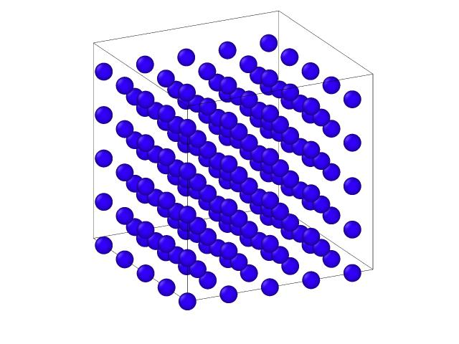
Initial position and velocities
Potential energy
Lennard-Jones (LJ)
Hard-sphere
Finnis–Sinclair (FS)
Sutton–Chen
Embedded atom method (EAM)
Modified Embedded atom method (MEAM)
Reference: http://www.ide.titech.ac.jp/~takahak/pub/ORAN/EAMlecture.pdf

Slide 3
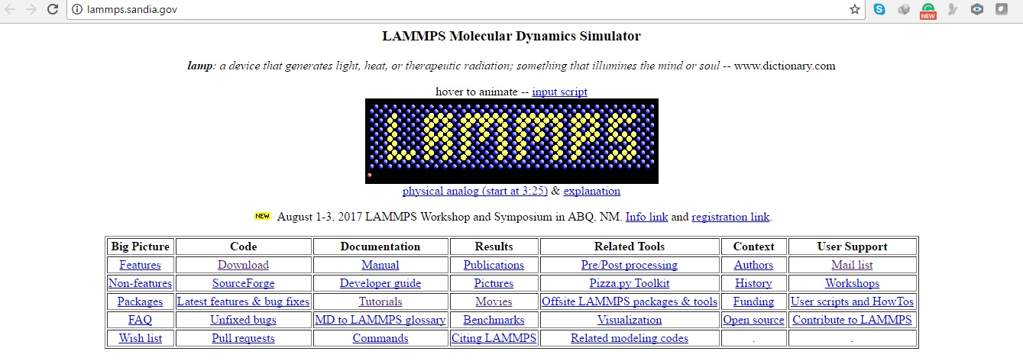
Large-scale Atomic/Molecular Massively Parallel Simulator (LAMMPS)
Lammps Manual
http://lammps.sandia.gov/doc/Manual.html
Lammps Tutorial
https://icme.hpc.msstate.edu/mediawiki/index.php/LAMMPS_tutorials

Slide 4
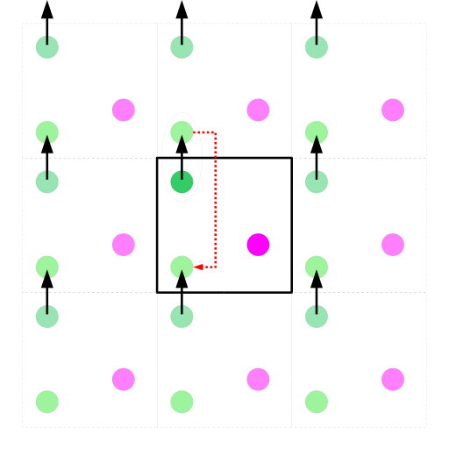
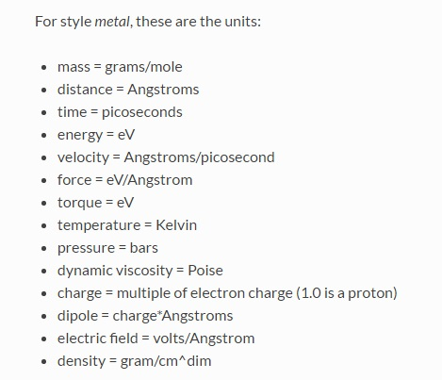
# ===================Initialize Simulation =============
clear
units metal
dimension 3
boundary p p p
atom_style atomic
# =================================================
Reference: https://en.wikipedia.org/wiki/Periodic_boundary_conditions

Slide 5
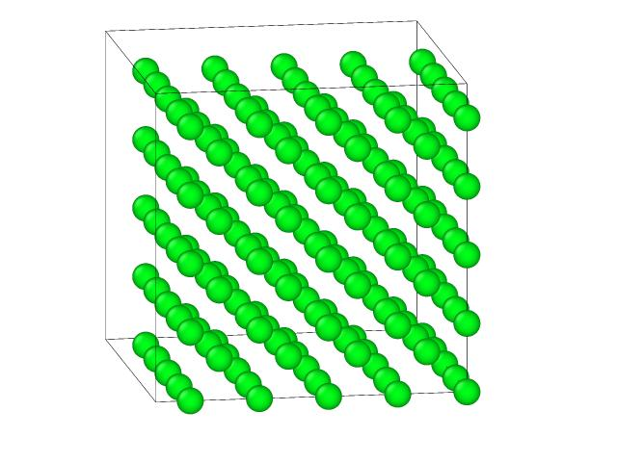
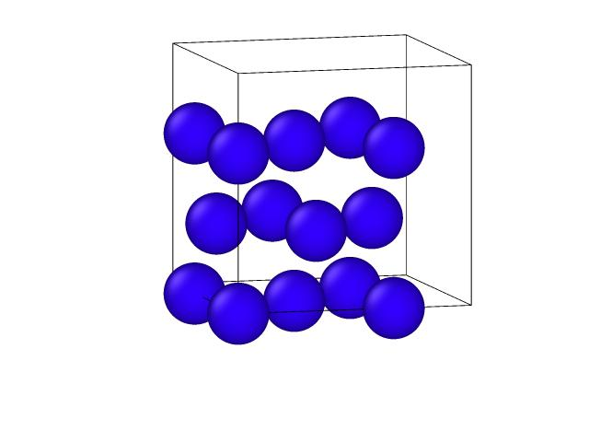
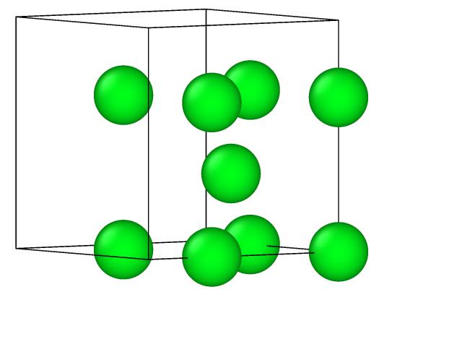
#==================== Create Atoms =================
lattice fcc 4 orient x 1 0 0 orient y 0 1 0 orient z 0 0 1
region box block 0 1 0 1 0 1 units lattice
create_box 1 box
create_atoms 1 box
replicate 1 1 1
# =================================================

Slide 6
#================Define Interatomic Potential =============
pair_style eam/fs
pair_coeff * * Mendelev_Cu2_2012.eam.fs Cu
neighbor 2.0 bin
neigh_modify delay 10 check yes
# =================================================

Slide 7
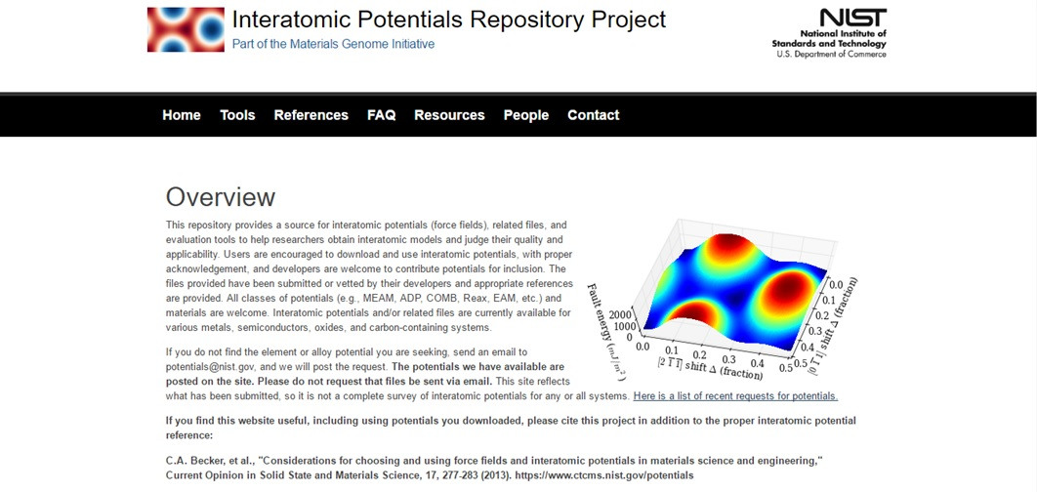

Slide 8
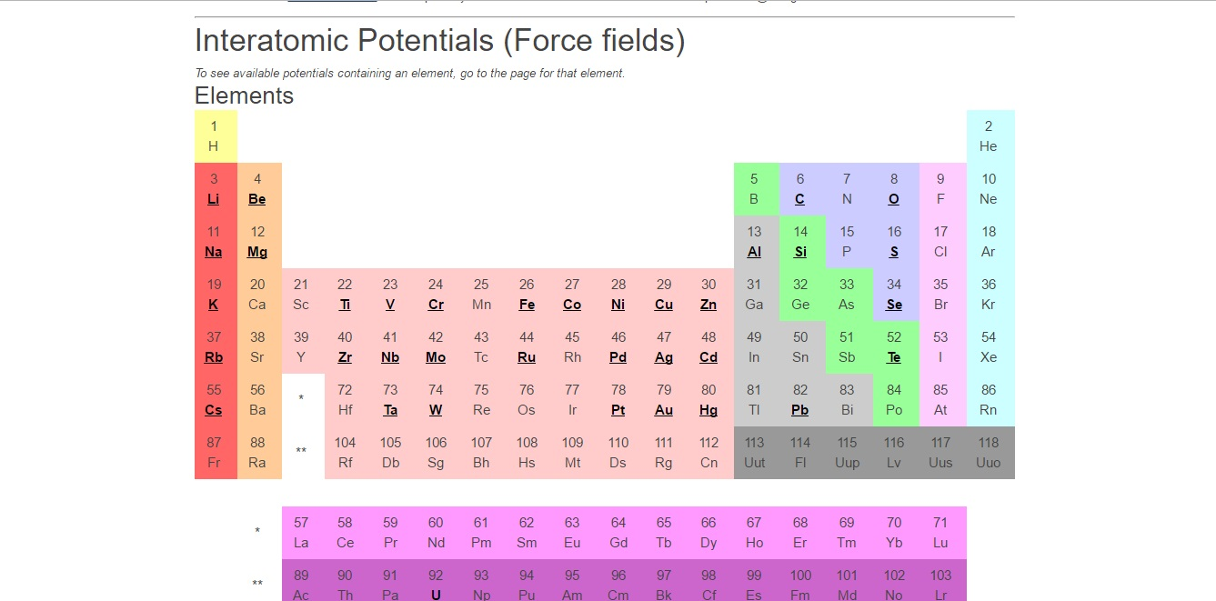

Slide 9
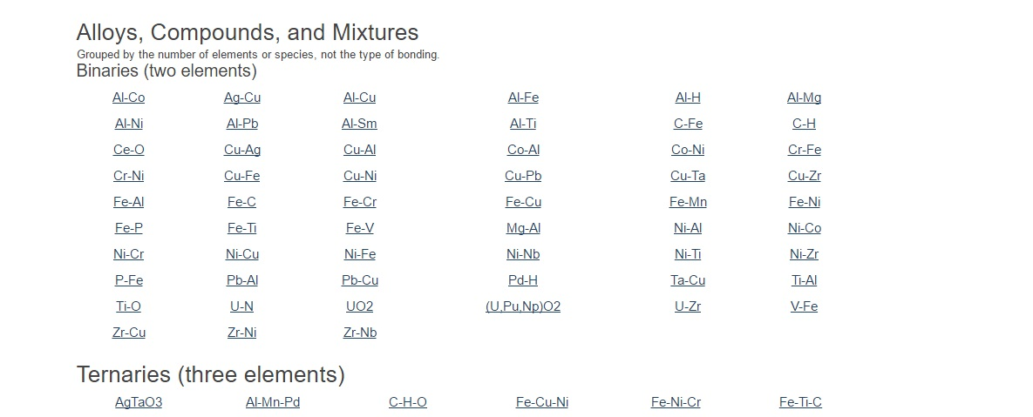

Slide 10
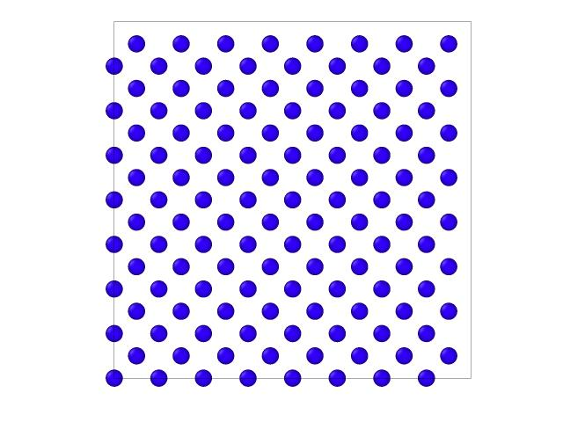
Number of Interactions
8 unit cell
Interatomic forces decrease strongly with distance
By introducing cut-off radius we can limit the calculation of force
8 unit cell

Slide 11
Looking for atoms in the cut-off distance is time consuming
r_{cutoff}
8 unit cell
By introducing neighboring list we can limit the calculation for finding atom in the cut-off distance
8 unit cell

Slide 12
The movements of atom during many time steps are lower than 0.2 Å
r_{skin}
By tabulation of neighboring atoms we can decrease the time of searching for the atoms in the cut-off distance.
r_{cutoff}
8 unit cell
neighbor 2.0 bin
neigh_modify delay 10 check yes
2 Å skin thickness for
neighbor list binning
Build neighbor list every 10
steps, but check atom moved
more than half skin thickness
8 unit cell

Slide 13
ITEM: TIMESTEP
0
ITEM: NUMBER OF ATOMS
189
ITEM: BOX BOUNDS pp pp pp
0 18
0 18
0 18
ITEM: ATOMS id type x y z
1 1 0 0 0
2 1 2 2 2
3 1 4 0 0
5 1 8 0 0
#===================Define Compute===================
compute eng all pe/atom
compute eatoms all reduce sum c_eng
# =====================Dumping======================
dump atom all custom 50 dump*.cfg id type x y z

Slide 14
# =====================Set Minimization ===================
reset_timestep 0
fix 1 all box/relax iso 0.0 vmax 0.001
thermo 10
thermo_style custom step pe lx ly lz press pxx pyy pzz c_eatoms
min_style cg
minimize 1e-25 1e-25 5000 10000
# =================================================
Define fix 1 operating on all atoms relaxes box to an external isotropic pressure of 0.0 bar with a 0.1% maximum fractional volume change per step
Choose a minimization algorithm to use when a minimize command is performed (Polak-Ribiere version of the conjugate gradient (CG) algorithm)

Slide 15
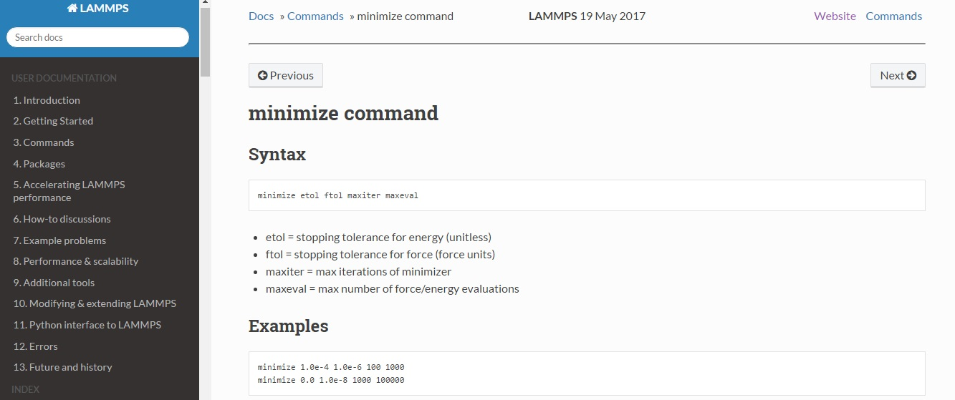
Reference: http://lammps.sandia.gov/doc/minimize.html

Slide 16
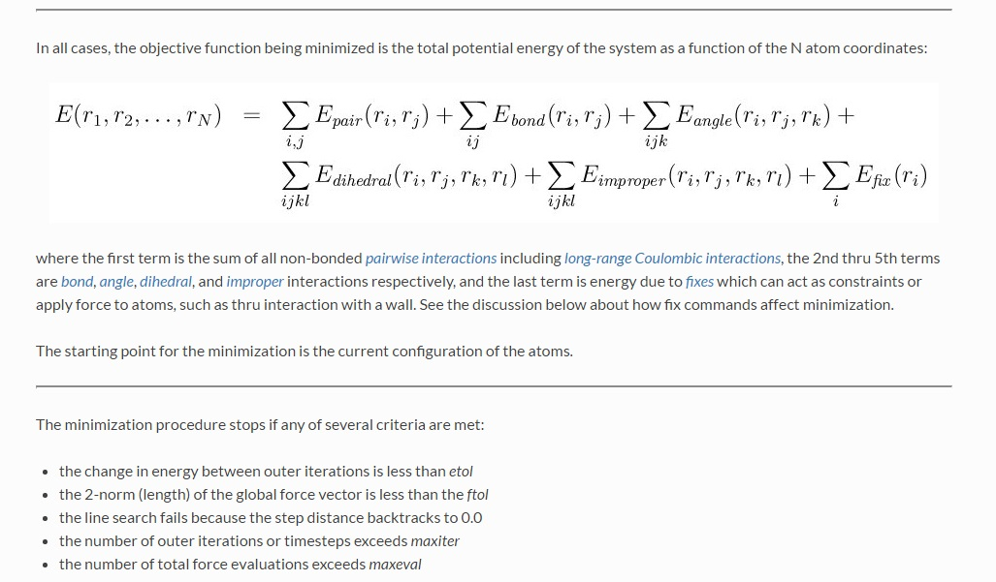
Reference: http://lammps.sandia.gov/doc/minimize.html

Slide 17
# ================================Defining Variable ====================================
variable natoms equal "count(all)"
variable teng equal "c_eatoms"
variable length equal "lx"
variable ecoh equal "v_teng/v_natoms"
# ==================================Printing output ====================================
print "Total energy (eV) = ${teng};"
print "Number of atoms = ${natoms};"
print "Lattice constant (Angstoms) = ${length};"
print "Cohesive energy (eV) = ${ecoh};"
print "%% Energy_fcc = ${ecoh};"
Print "%% Lattice_fcc = ${length};“
# ================================================================================

Slide 18


Slide 19
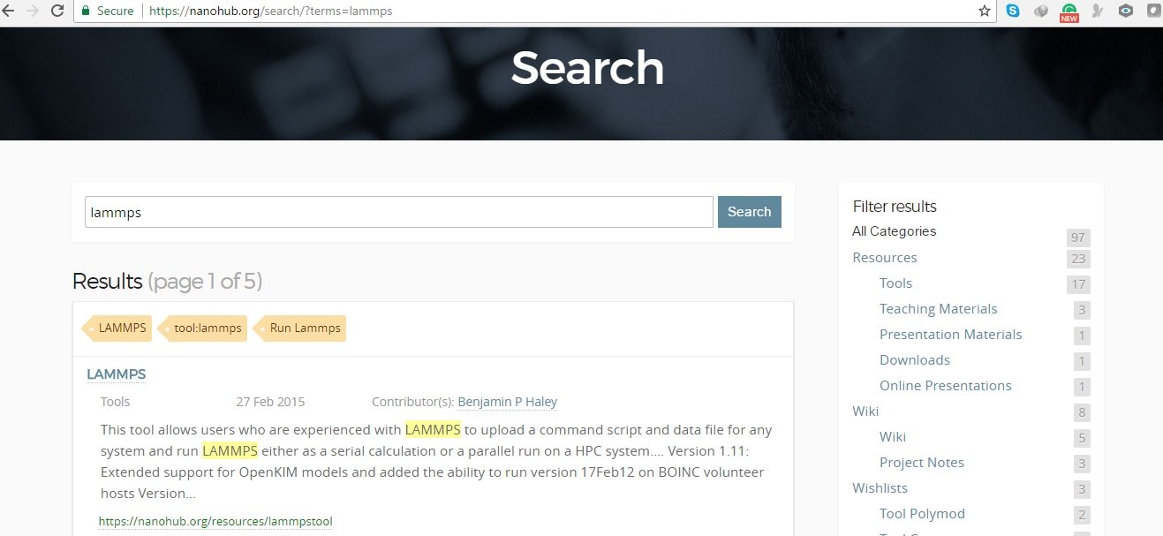

Slide 20


Slide 21
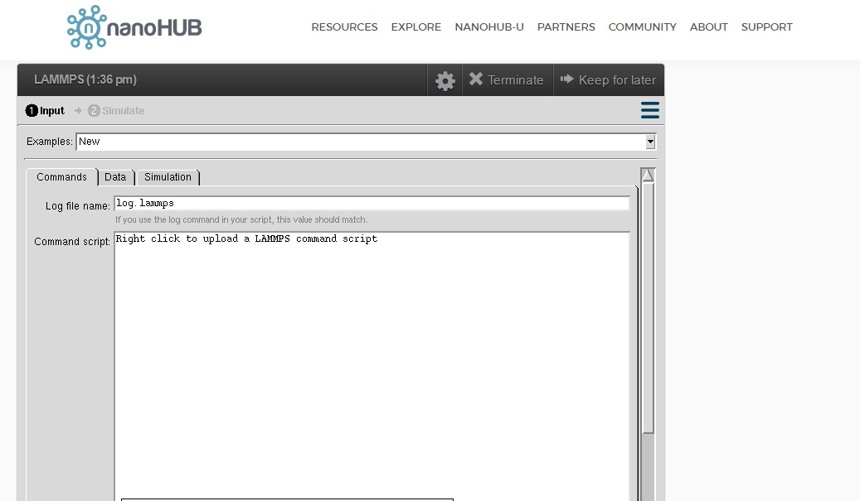

Slide 22
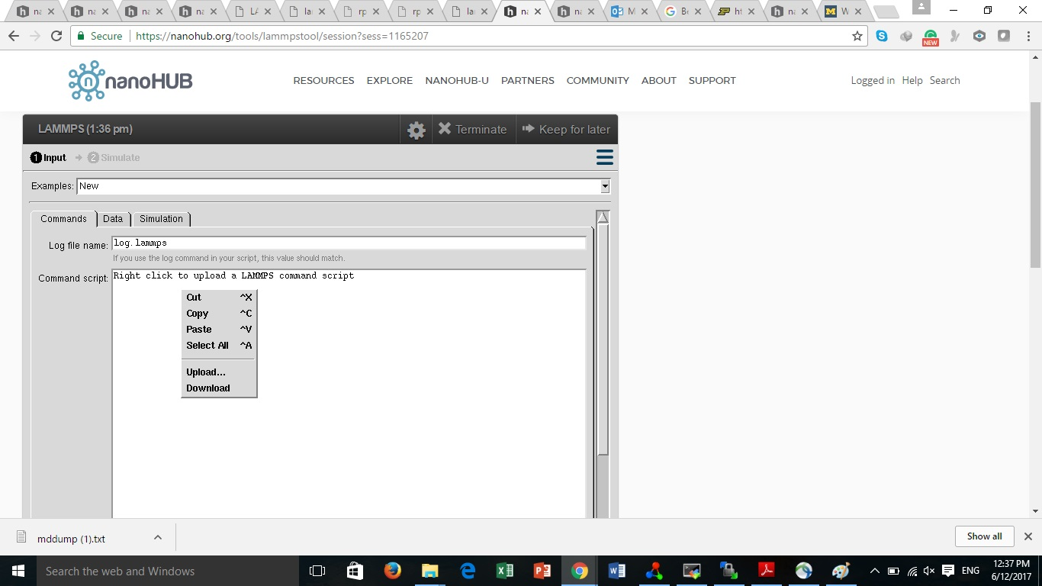

Slide 23
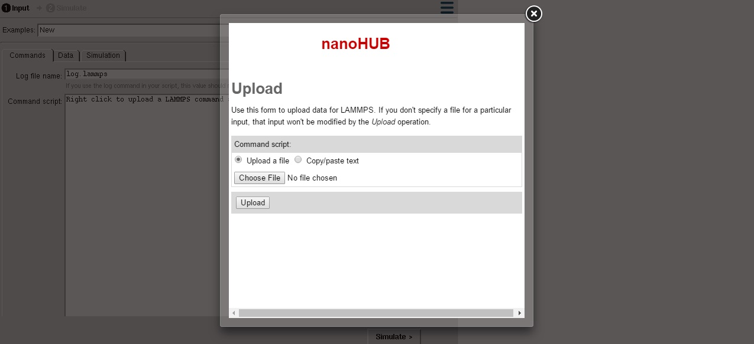

Slide 24
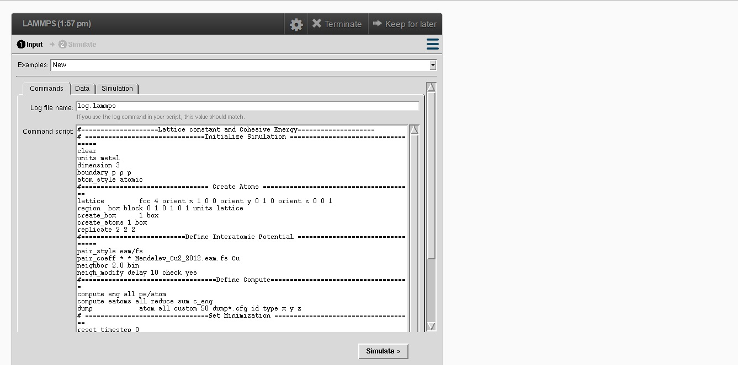

Slide 25
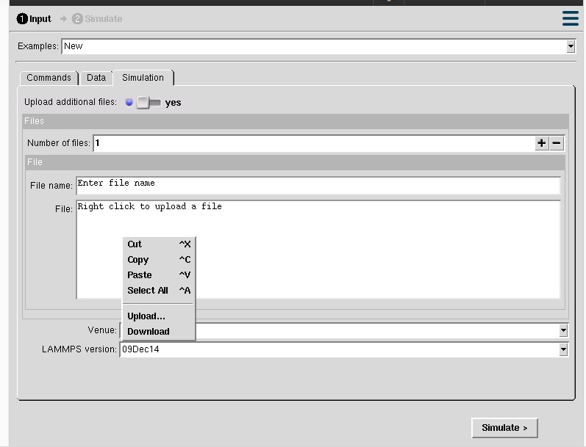

Slide 26
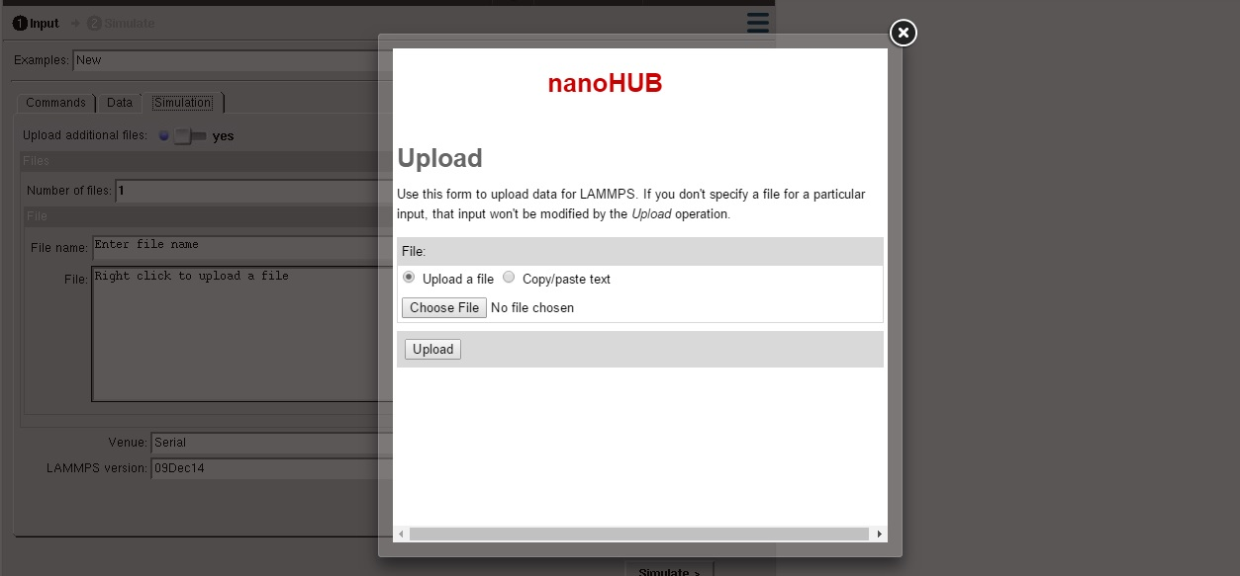

Slide 27
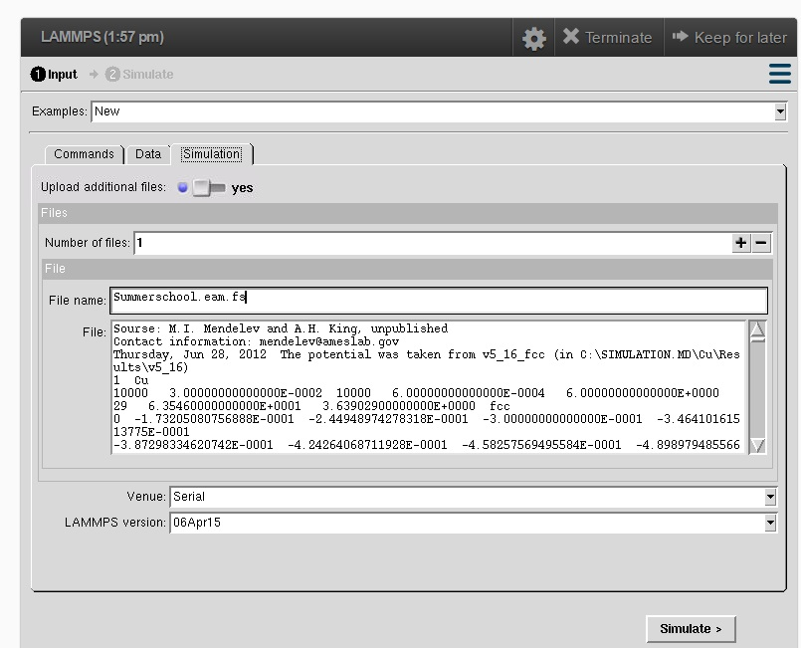

Slide 28
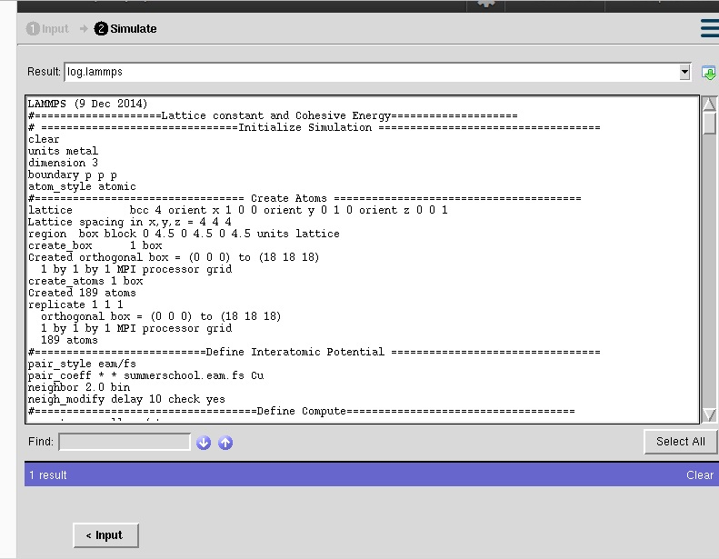

Slide 29
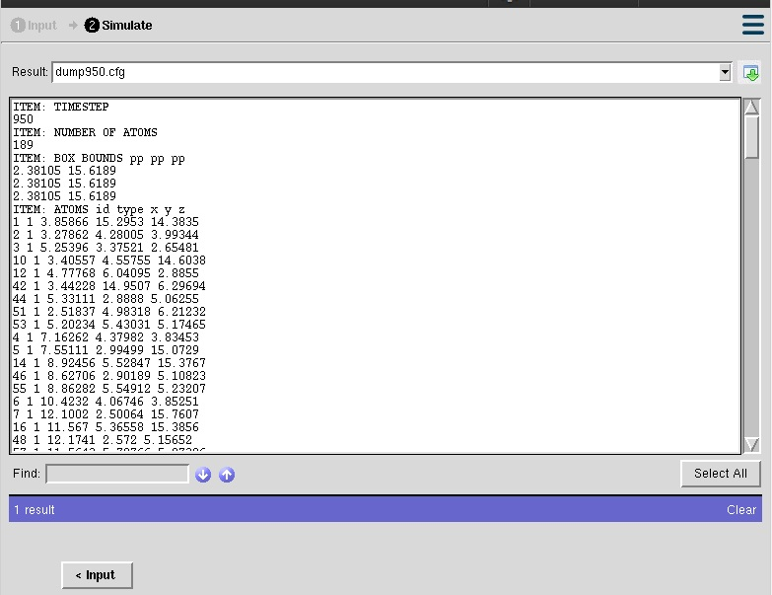

Slide 30
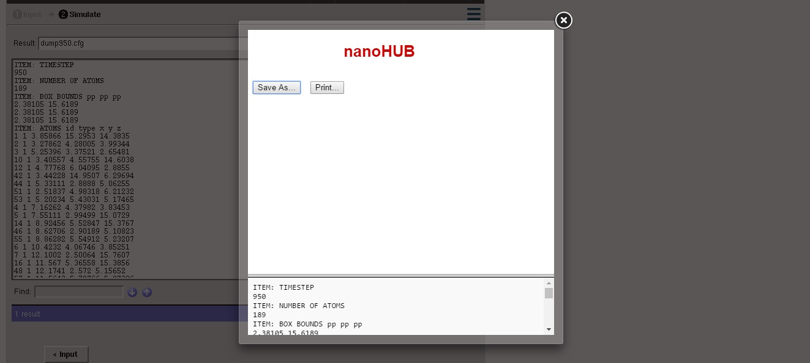

Slide 31
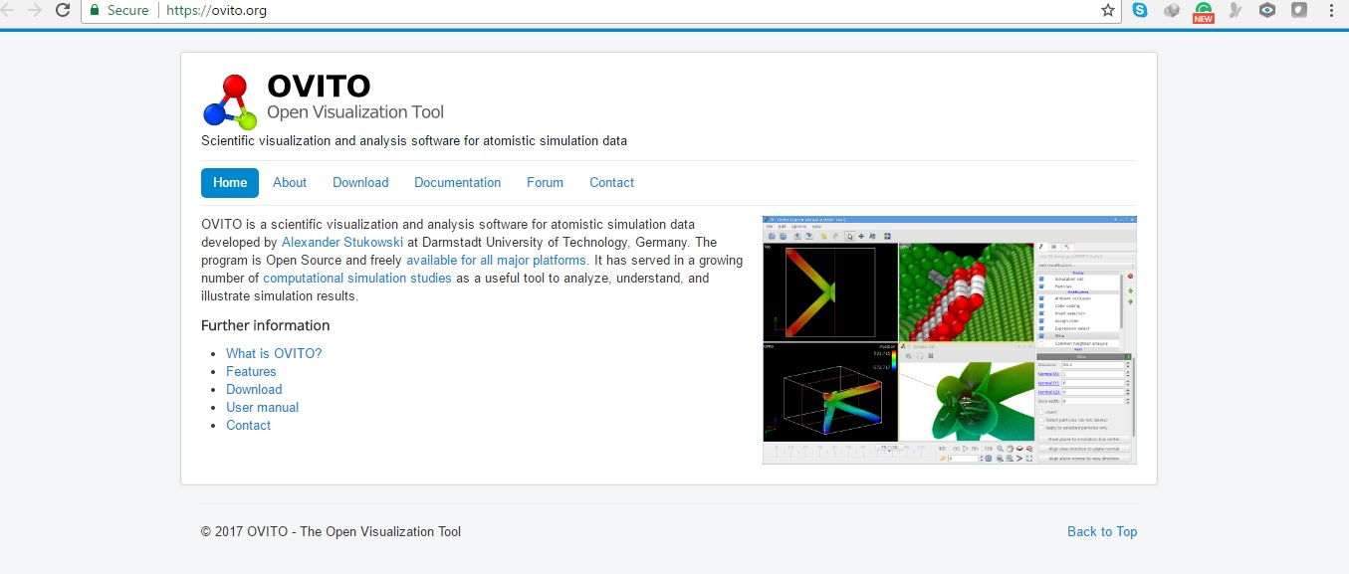
https://ovito.org/

Slide 32
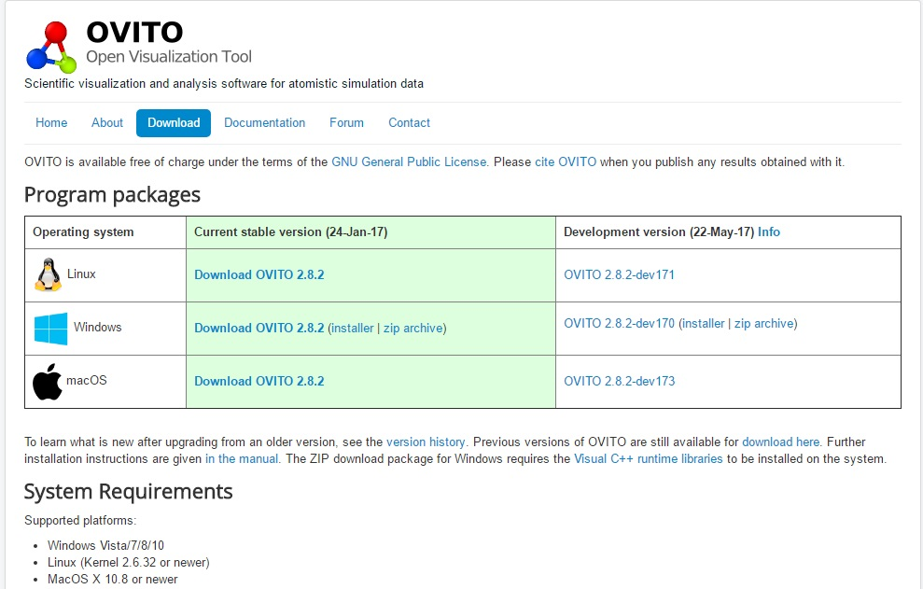

Slide 33
 | E_{coh}(eV) | a_{o}(A) | C₁₁ (Gpa) | C₁₂ (Gpa) | B (Gpa)
MD-calculation | -3.4227 | 3.639 | 174.62 | 127.46 | 143.8
Experimental | -3.49 | 3.614 | 176.2 | 124.9 | 142

